Slide 1

Course Code: INT232
DATA SCIENCE TOOLBOX : R PROGRAMMING
www.lpu.in Lovely Professional University
1

Slide 2


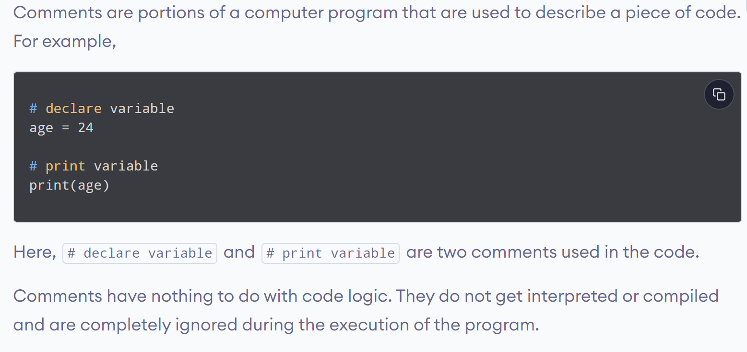
www.lpu.in Lovely Professional University
2

Slide 3
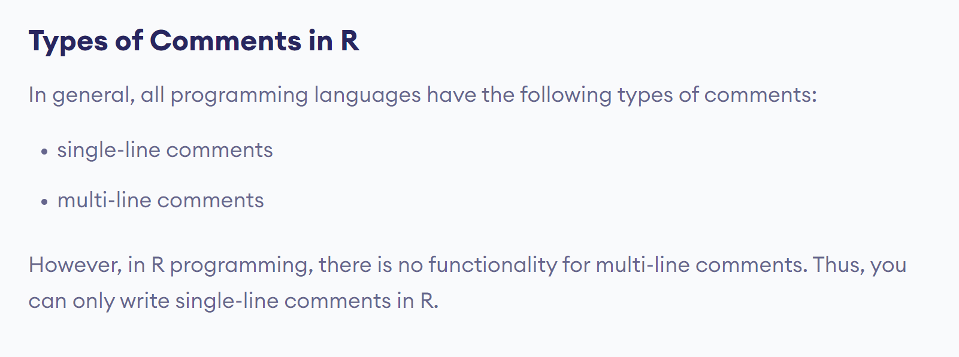
www.lpu.in Lovely Professional University
3

Slide 4
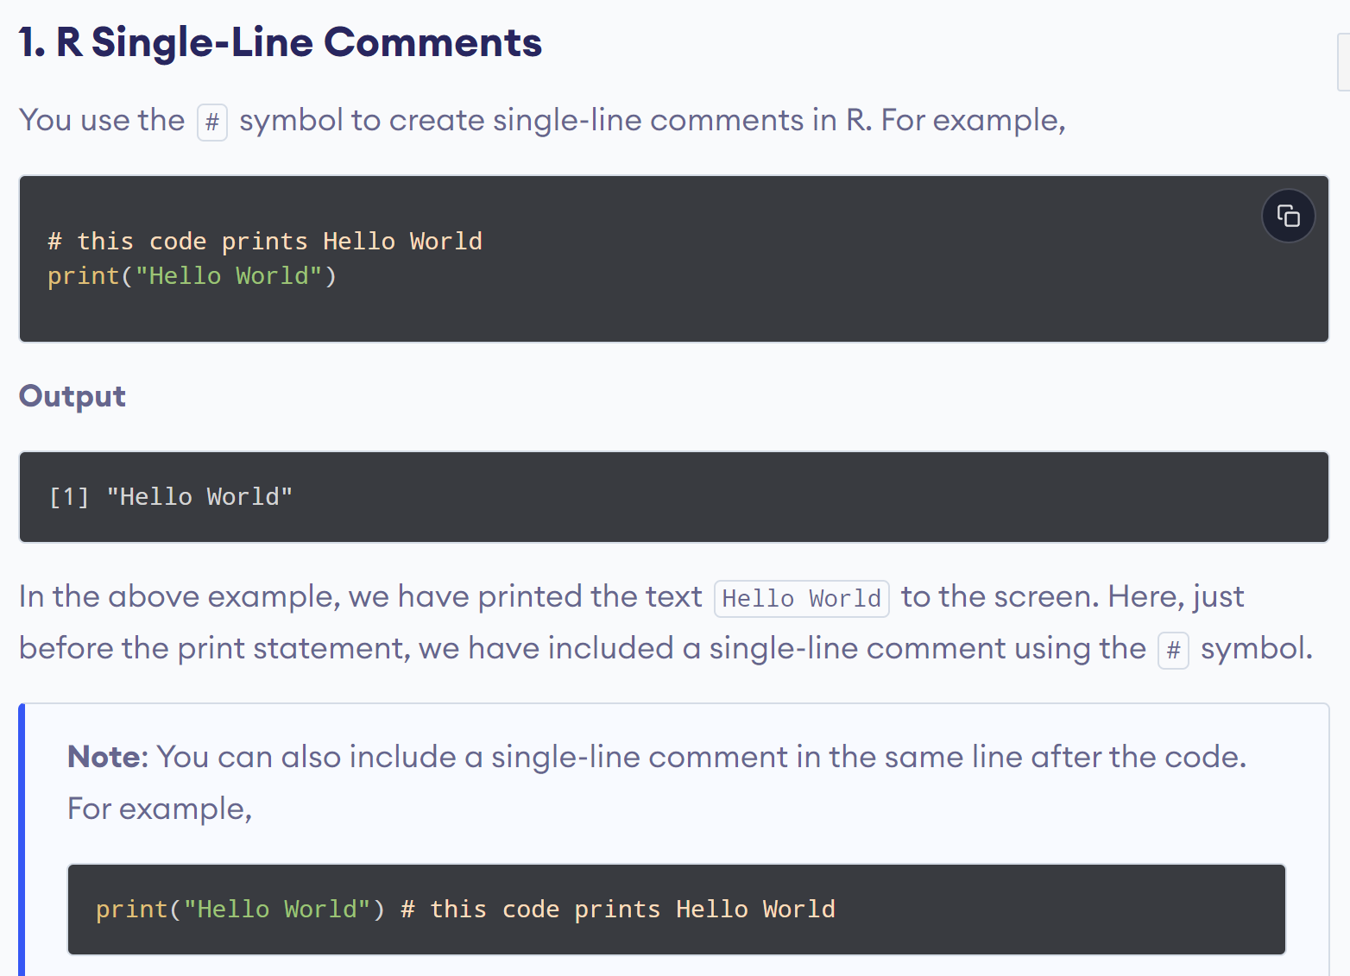
www.lpu.in Lovely Professional University
4

Slide 5
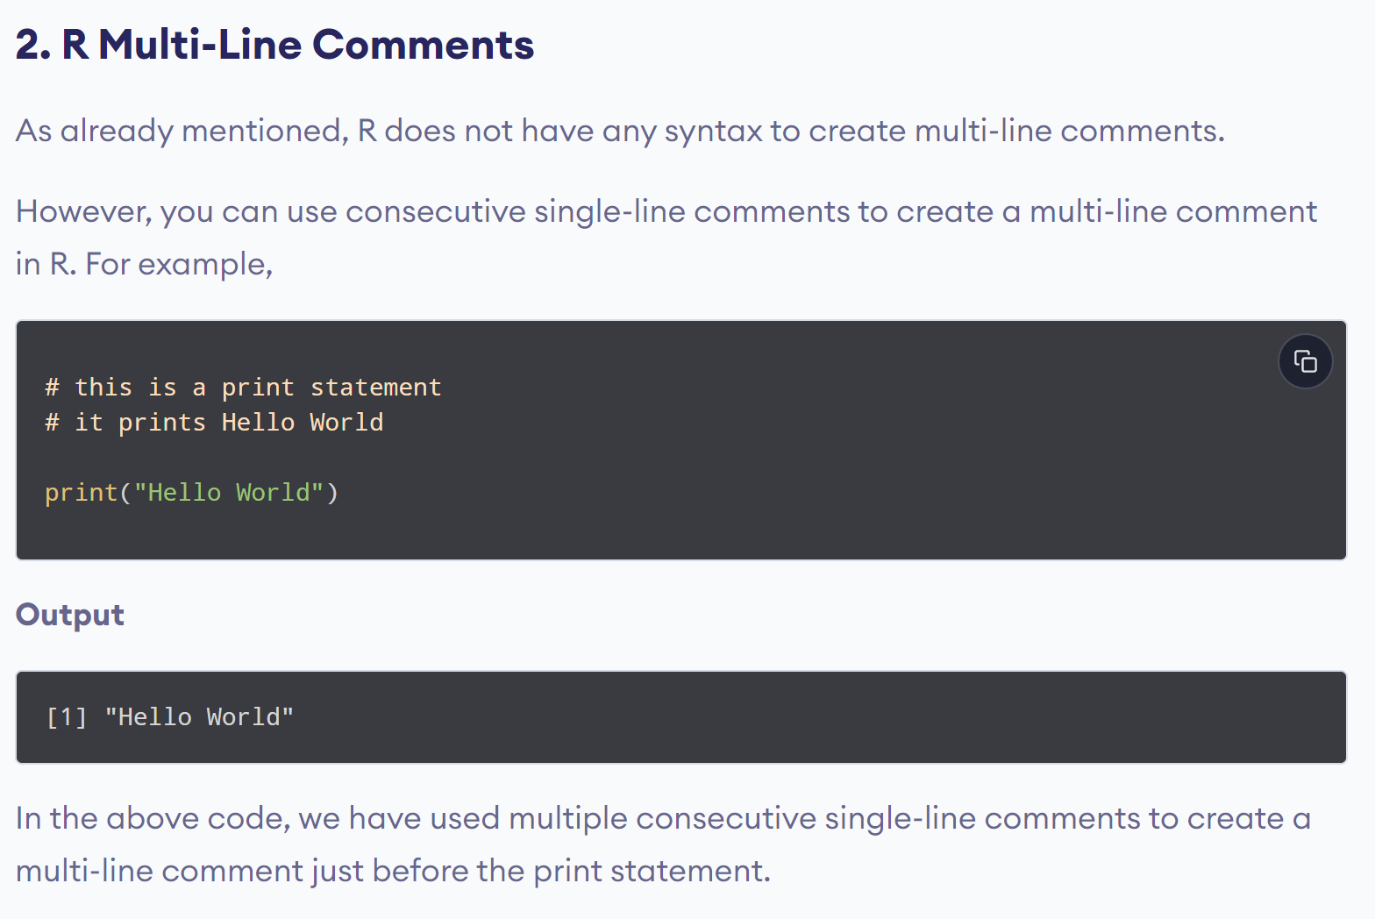
www.lpu.in Lovely Professional University
5

Slide 6
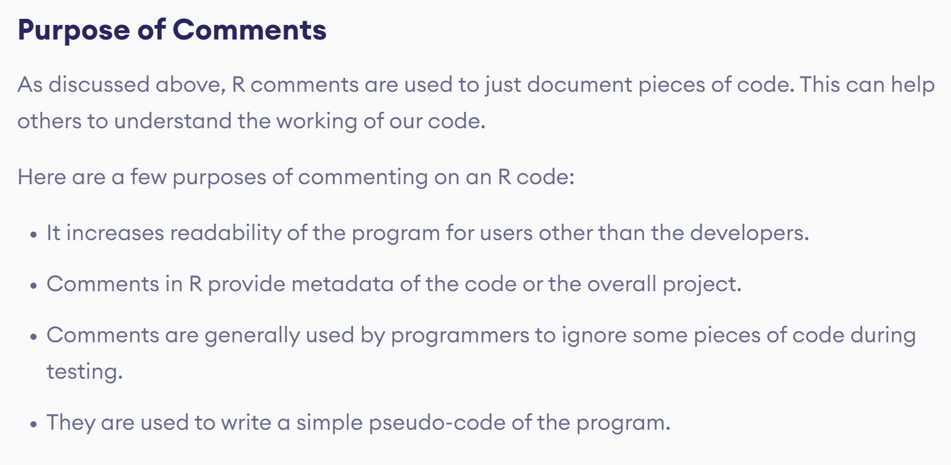
www.lpu.in Lovely Professional University
6

Slide 7
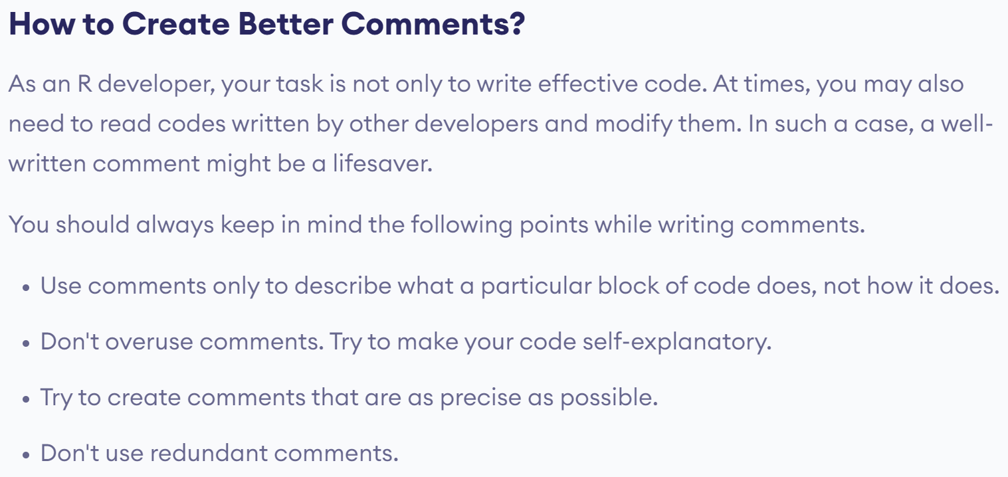
www.lpu.in Lovely Professional University
7

Slide 8

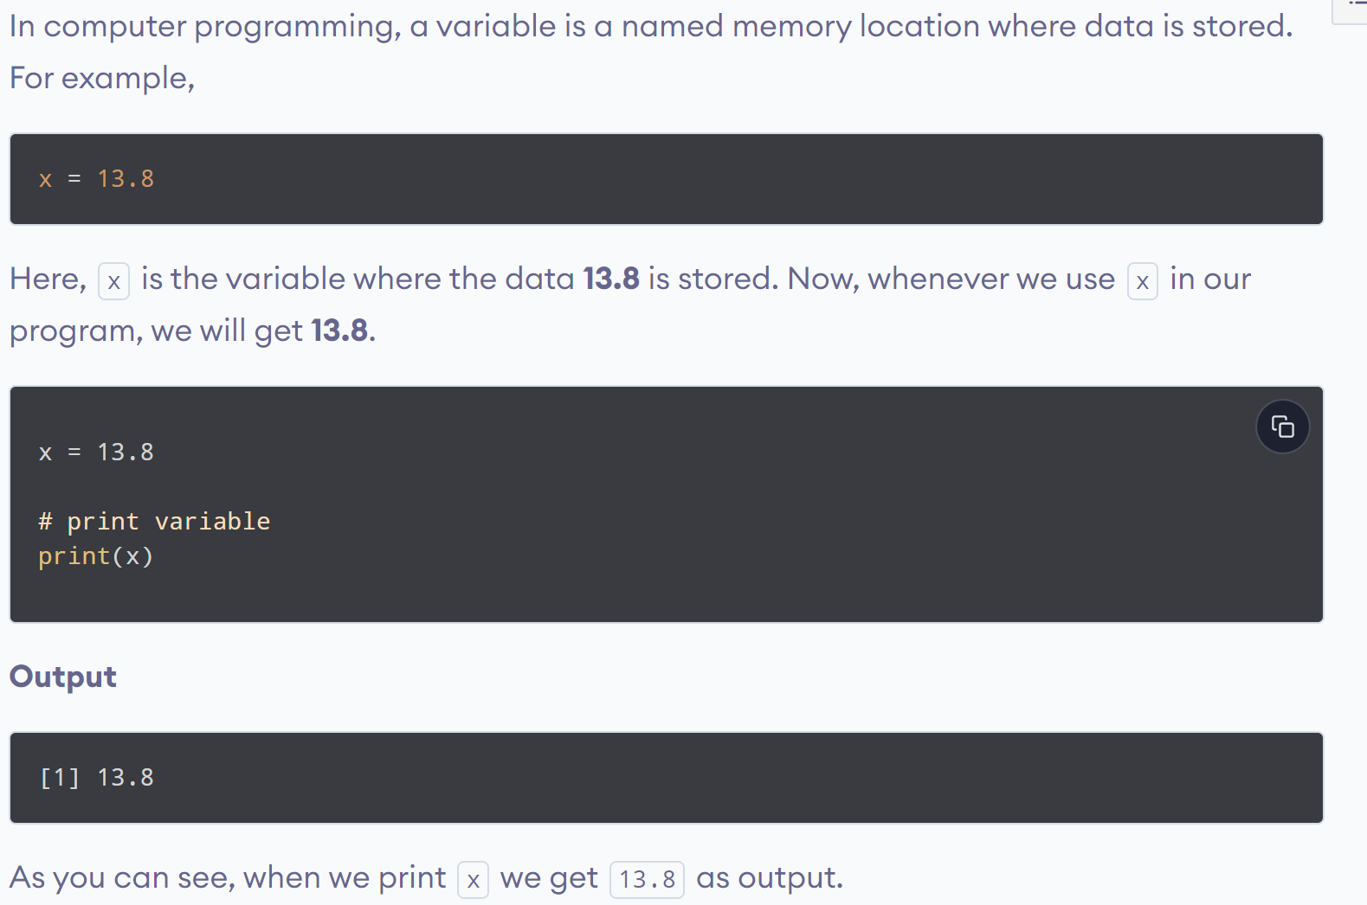
www.lpu.in Lovely Professional University
8

Slide 9
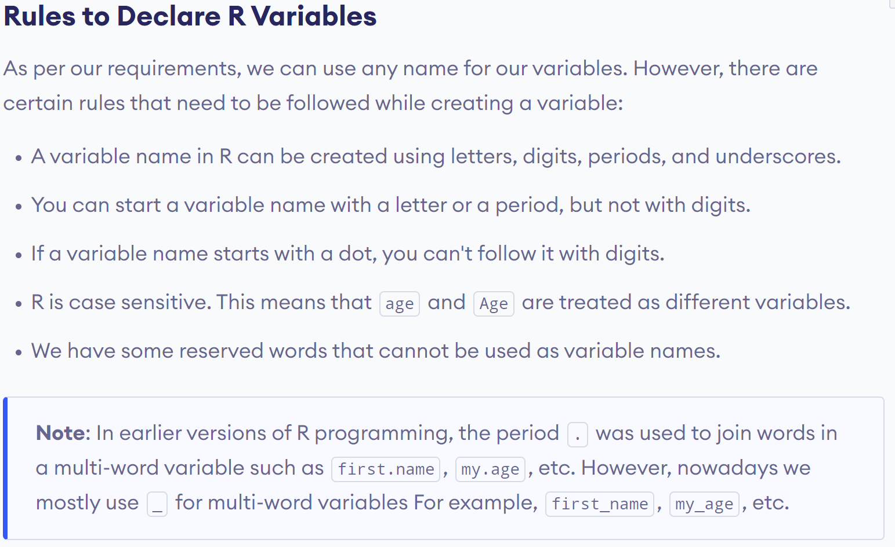
www.lpu.in Lovely Professional University
9

Slide 10
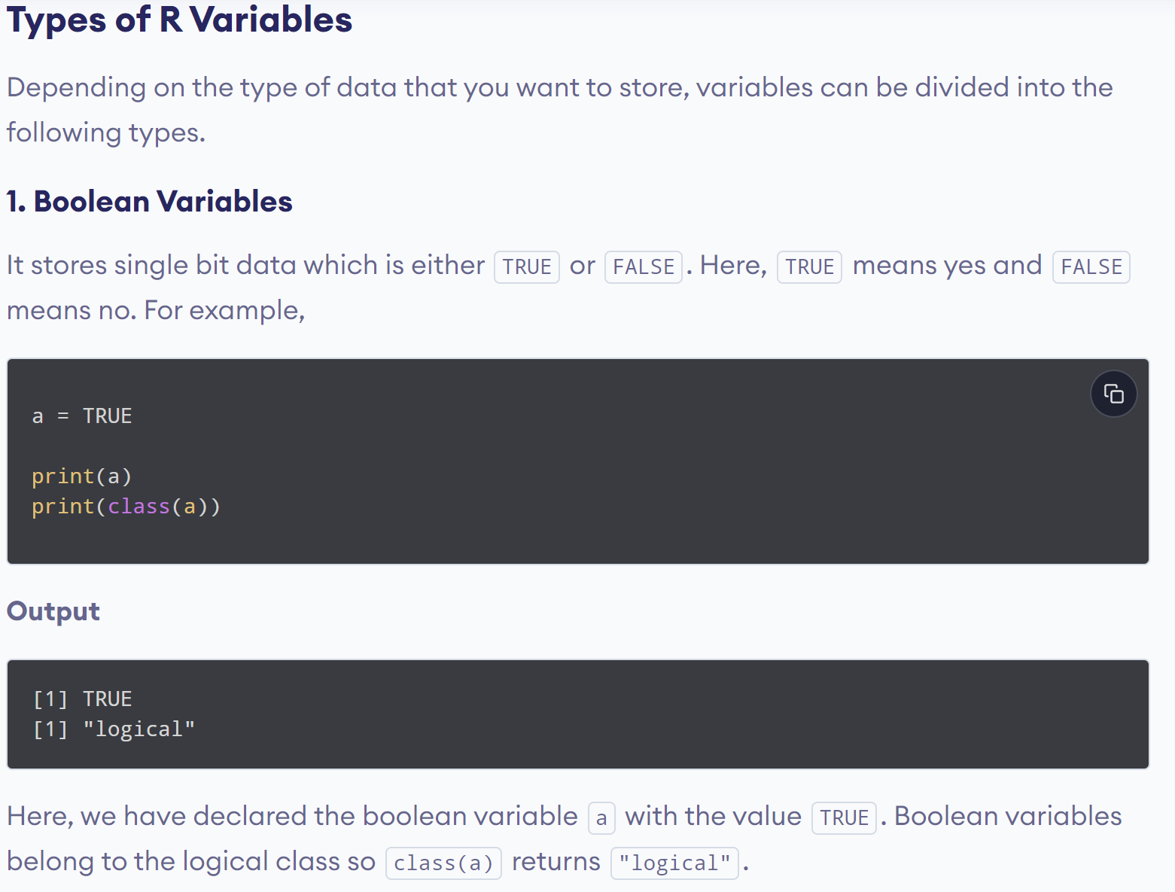
www.lpu.in Lovely Professional University
10

Slide 11
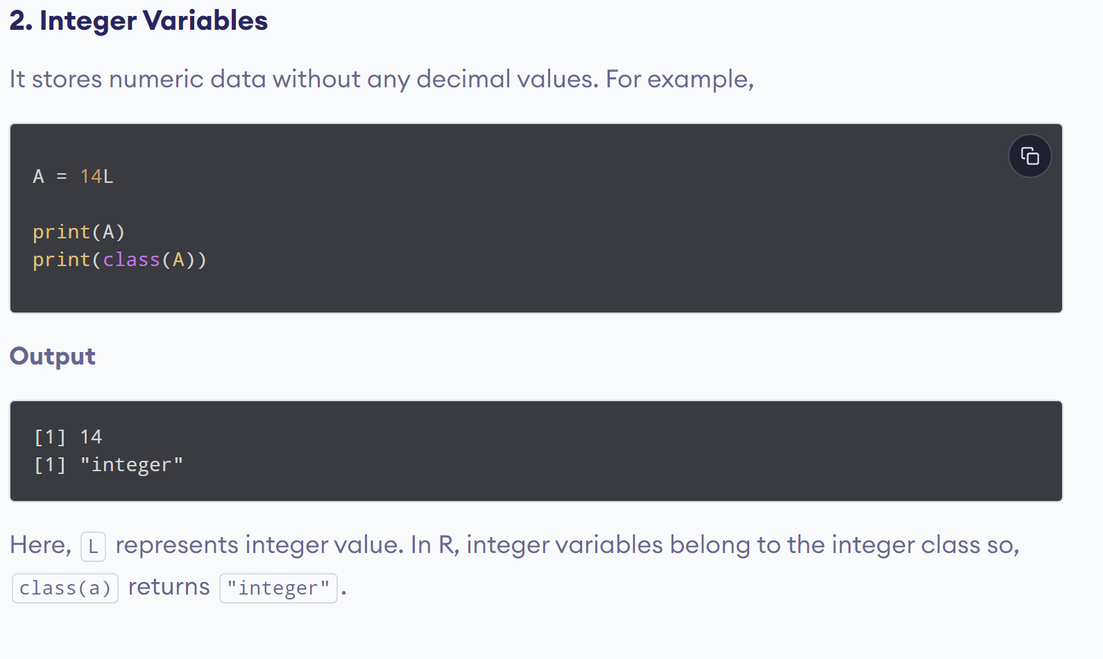
www.lpu.in Lovely Professional University
11

Slide 12
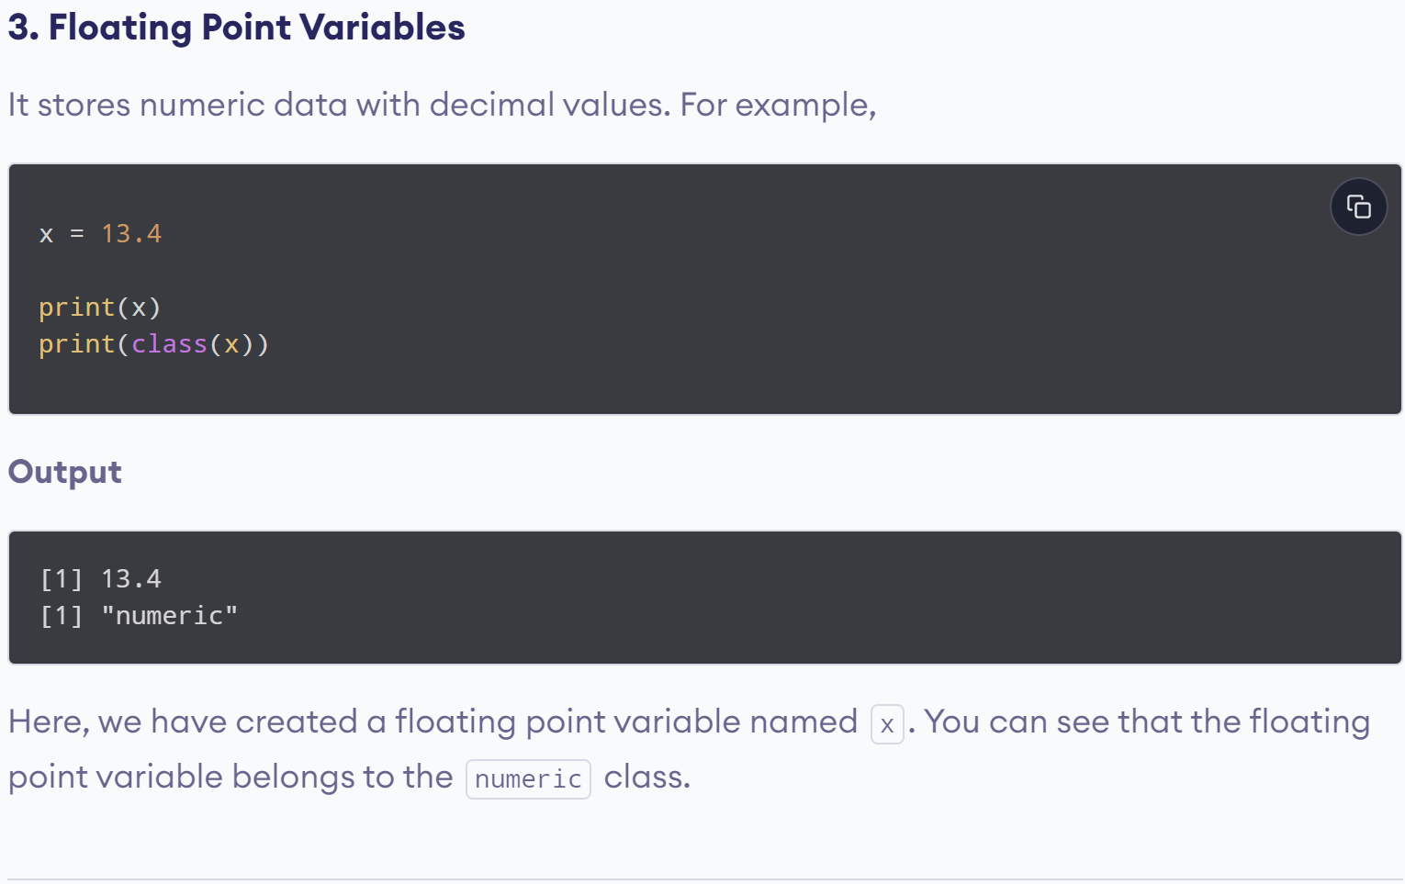
www.lpu.in Lovely Professional University
12

Slide 13
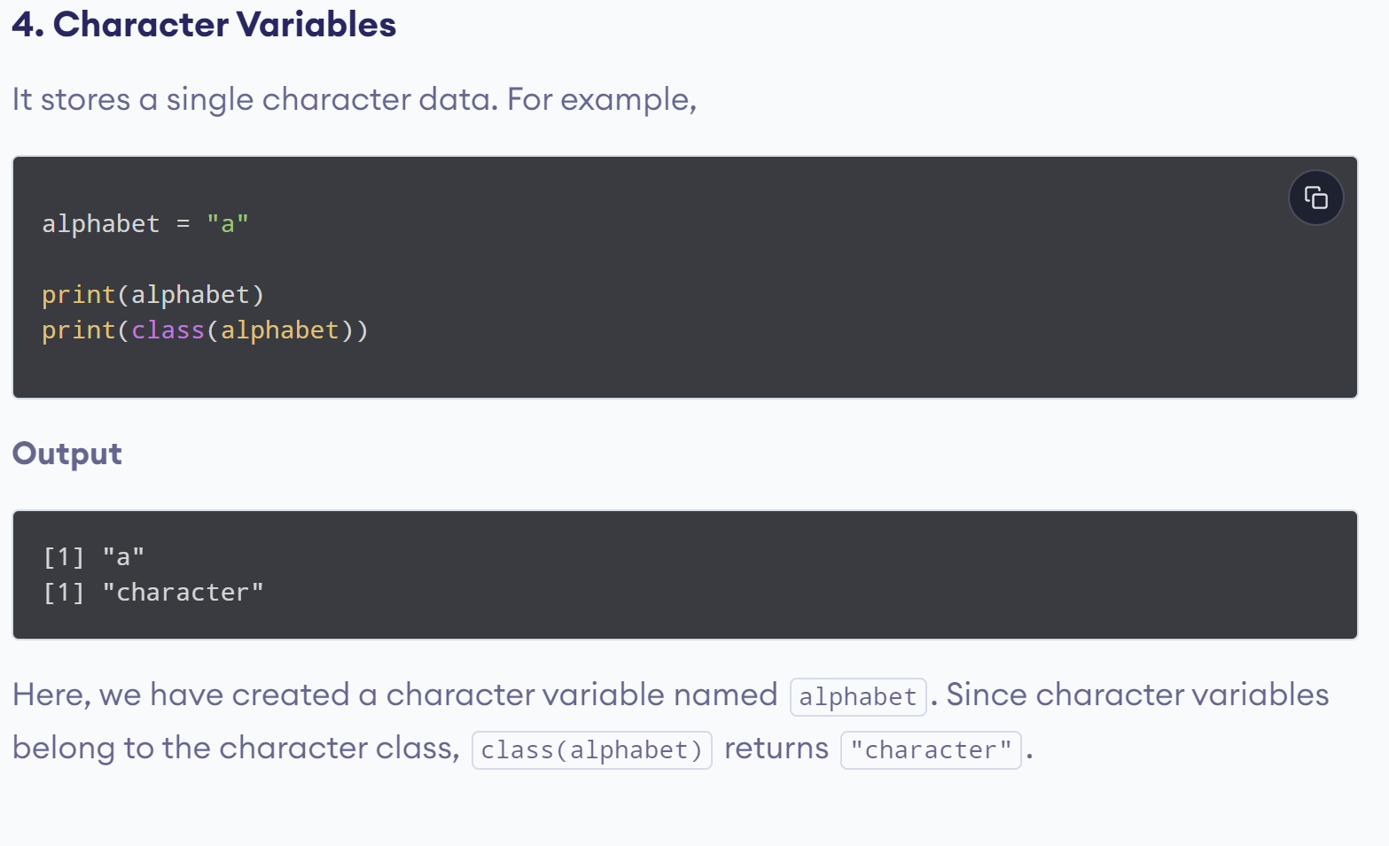
www.lpu.in Lovely Professional University
13

Slide 14
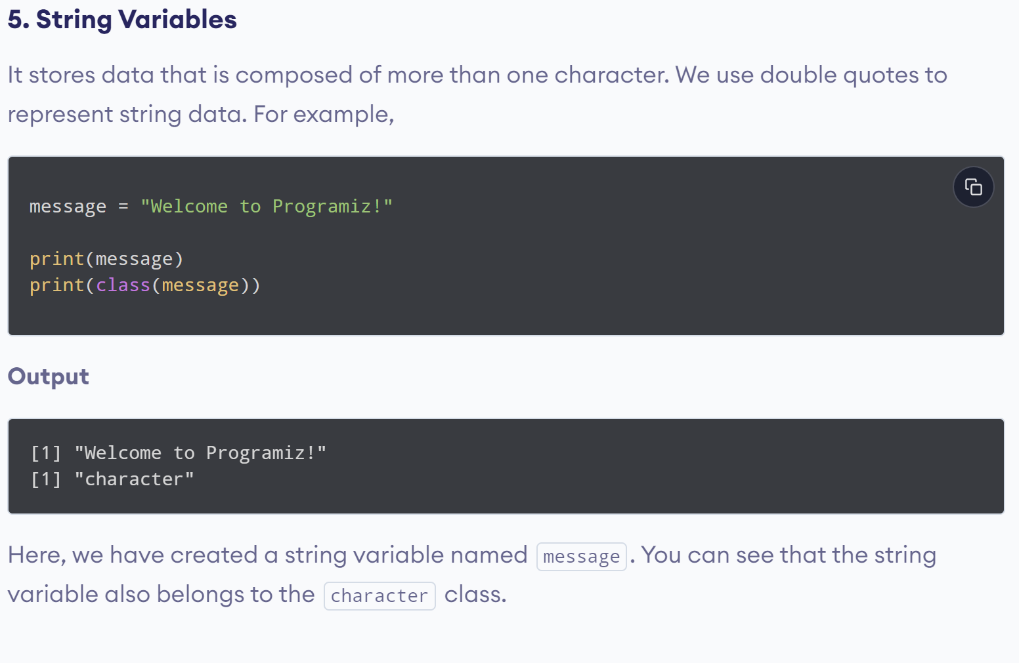
www.lpu.in Lovely Professional University
14

Slide 15
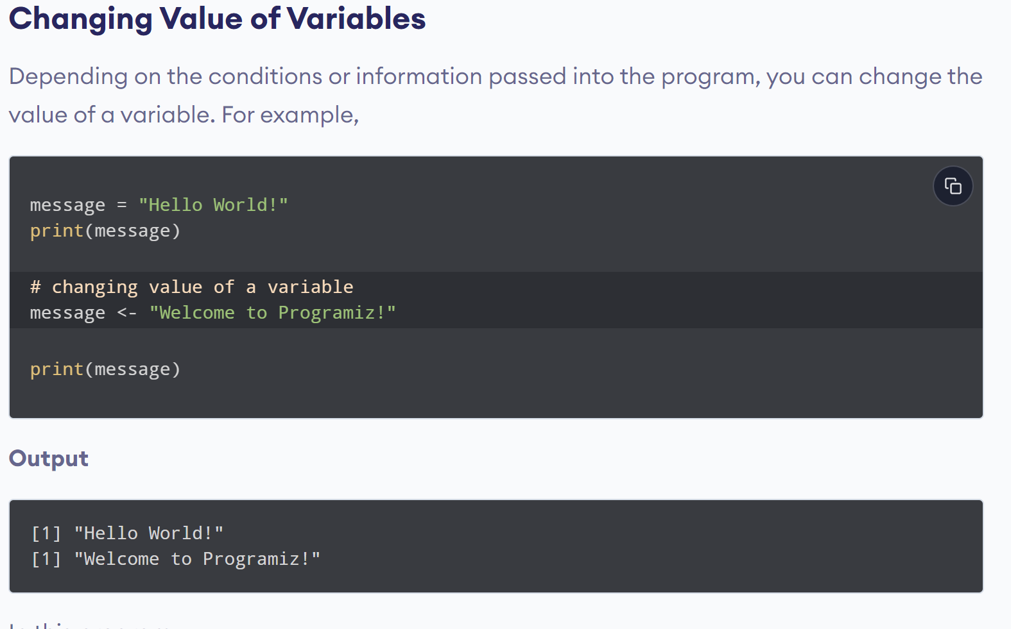
www.lpu.in Lovely Professional University
15

Slide 16
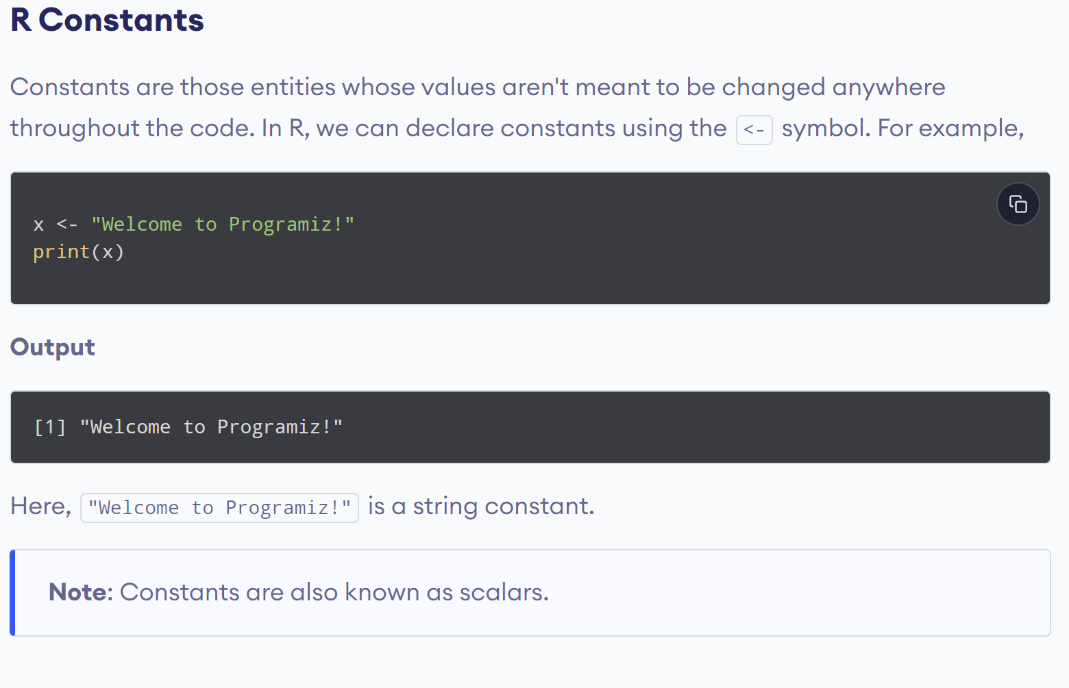
www.lpu.in Lovely Professional University
16

Slide 17
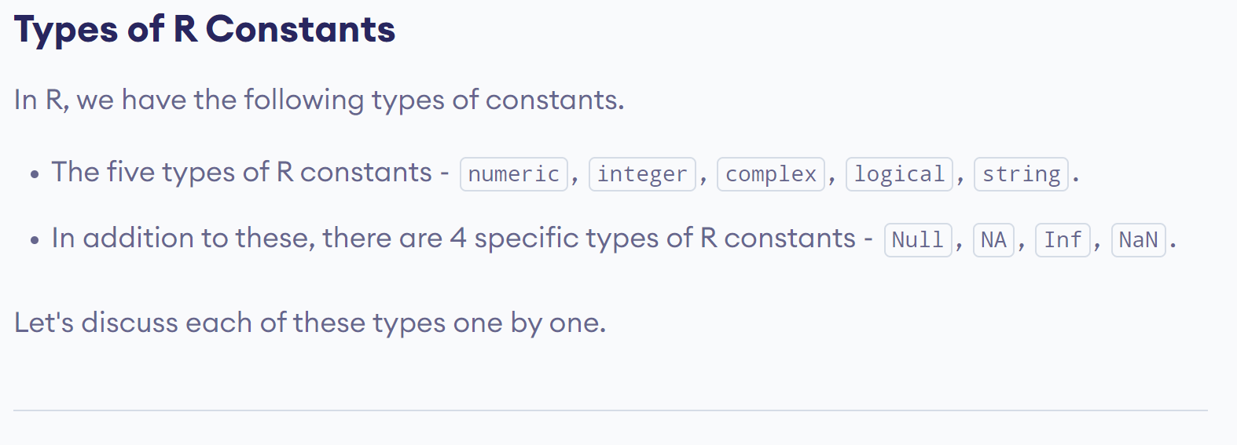
www.lpu.in Lovely Professional University
17

Slide 18
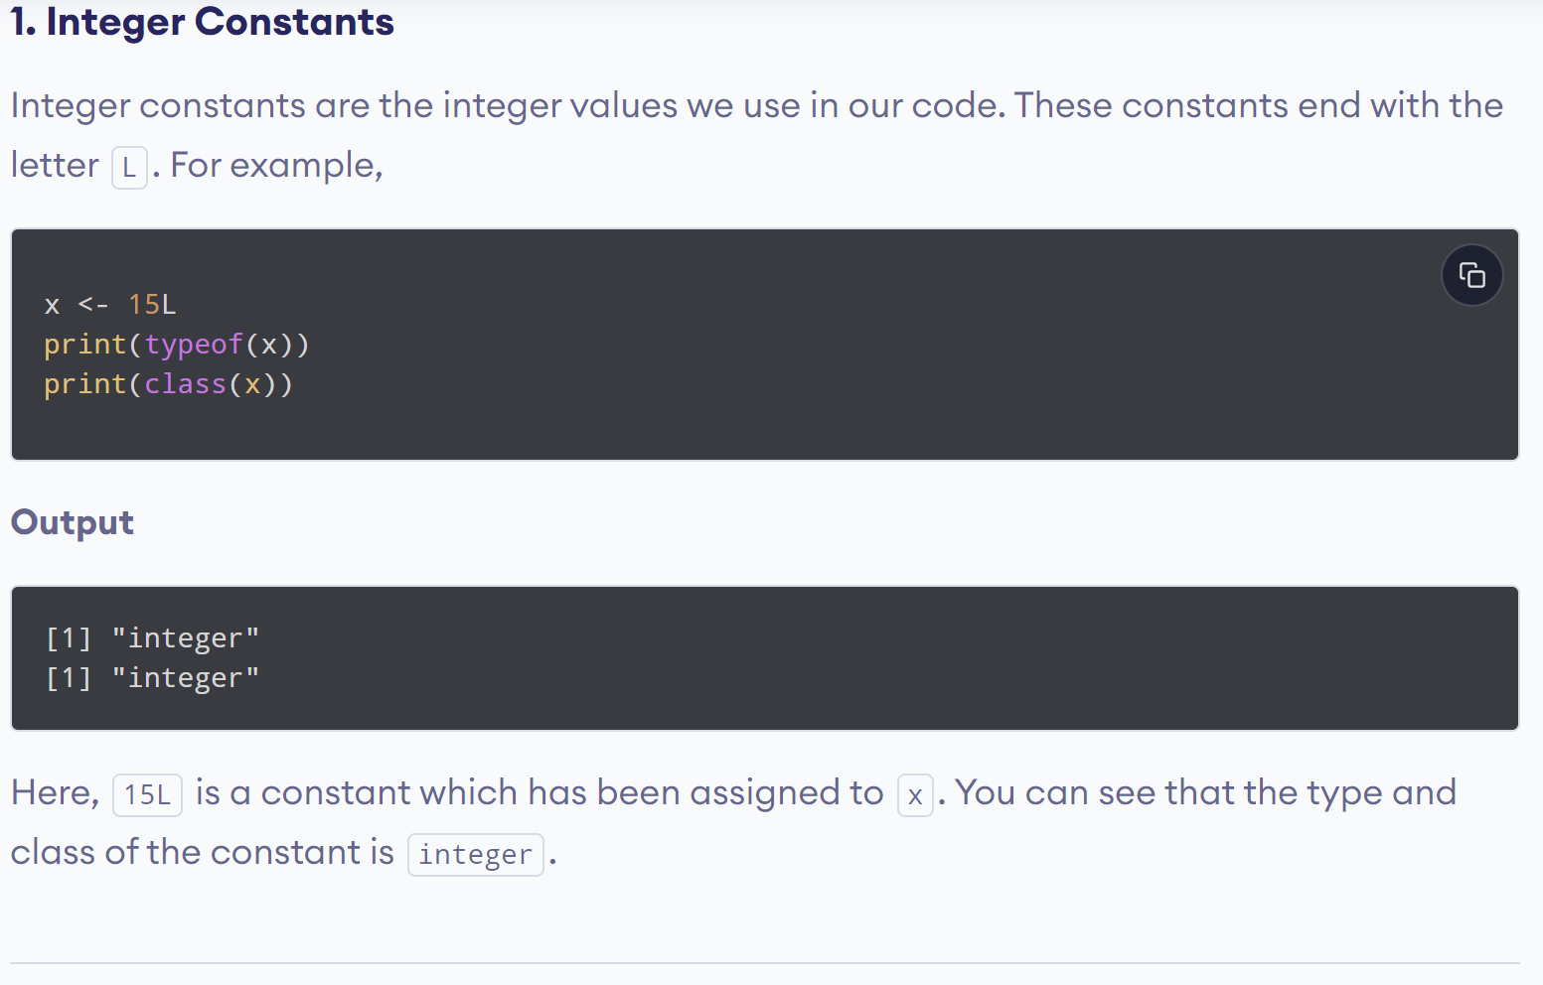
www.lpu.in Lovely Professional University
18

Slide 19
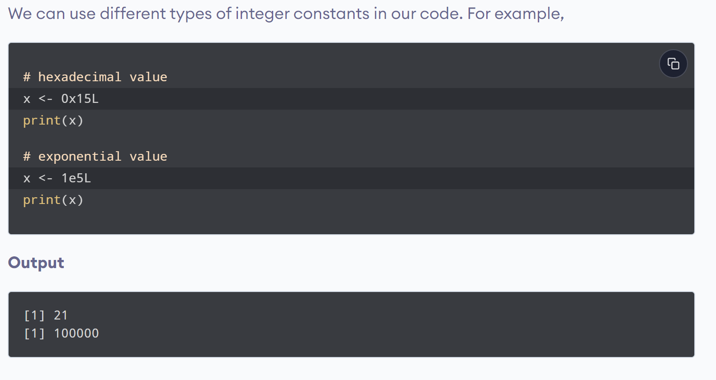
www.lpu.in Lovely Professional University
19

Slide 20
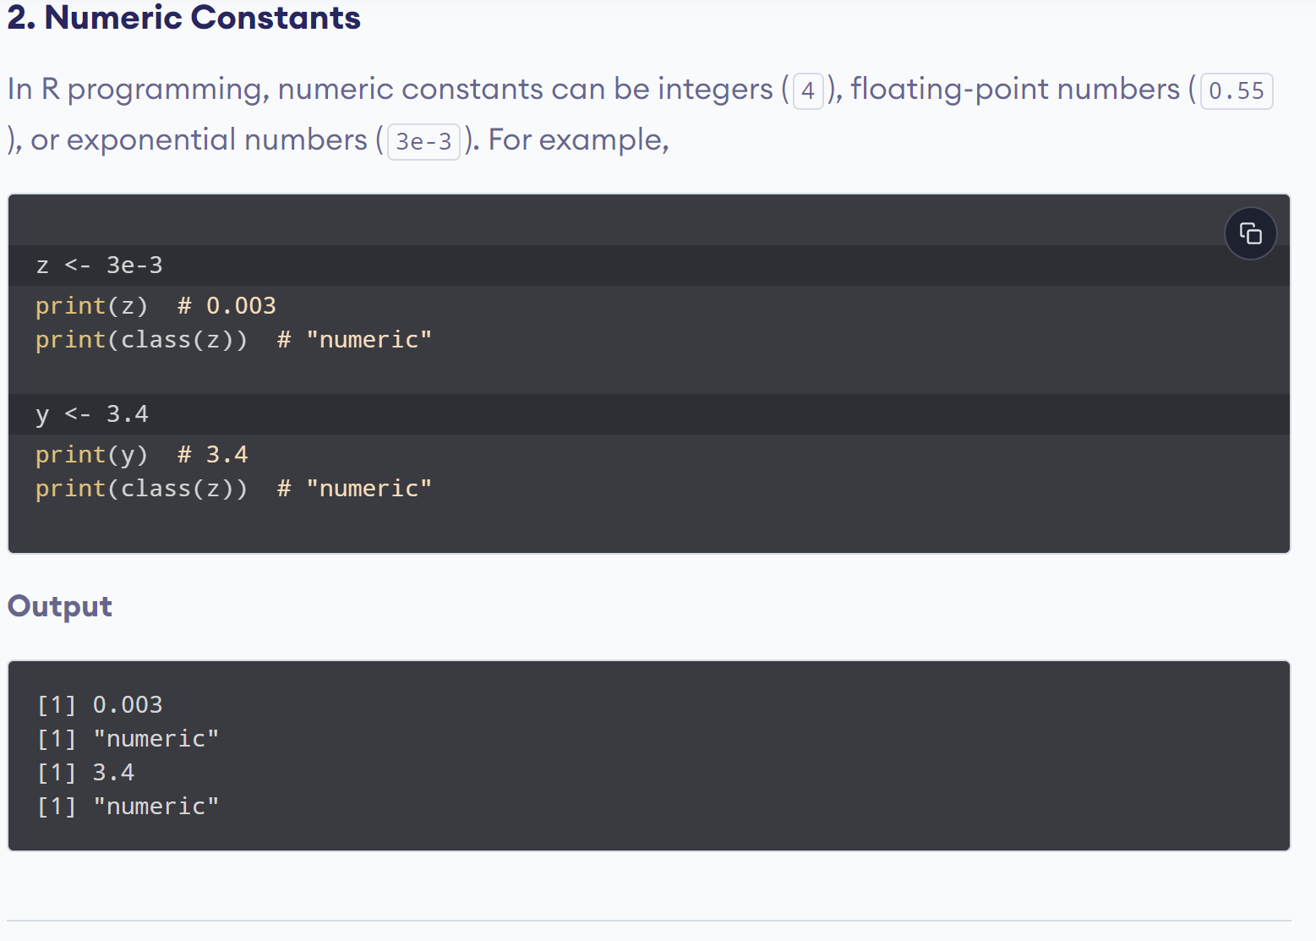
www.lpu.in Lovely Professional University
20

Slide 21
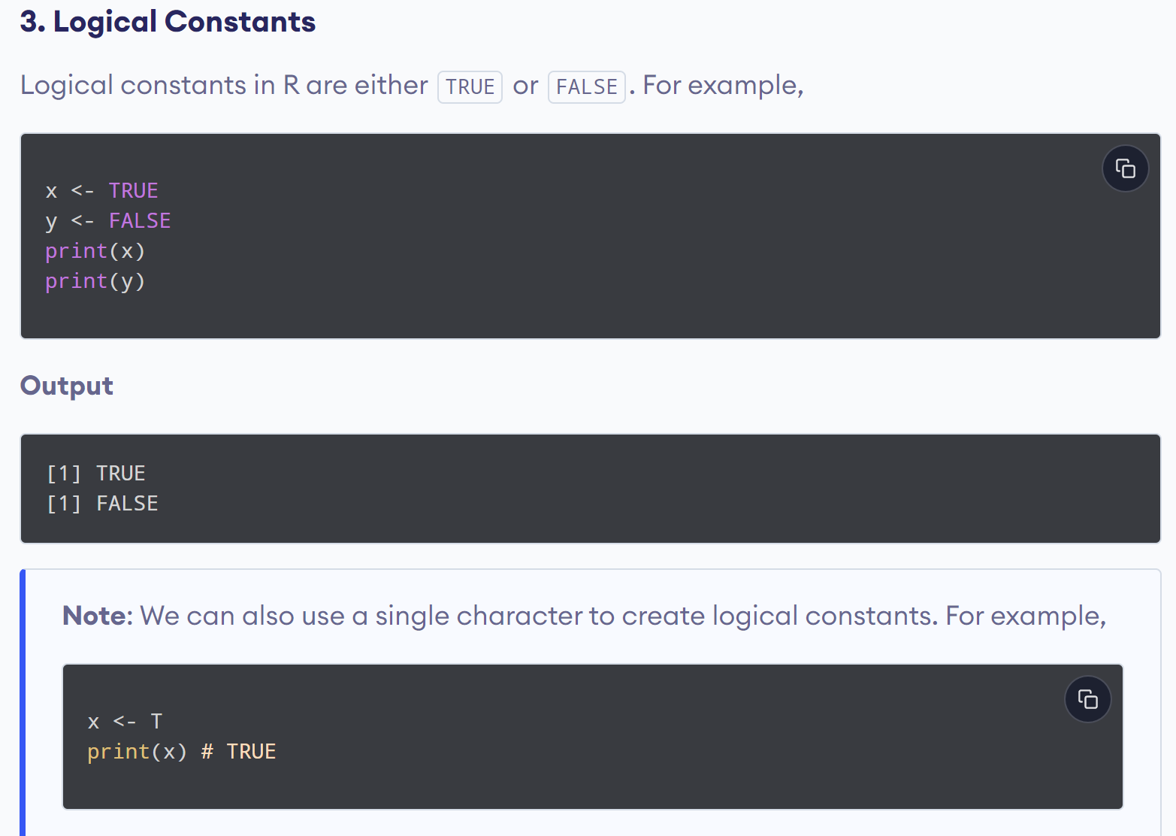
www.lpu.in Lovely Professional University
21

Slide 22
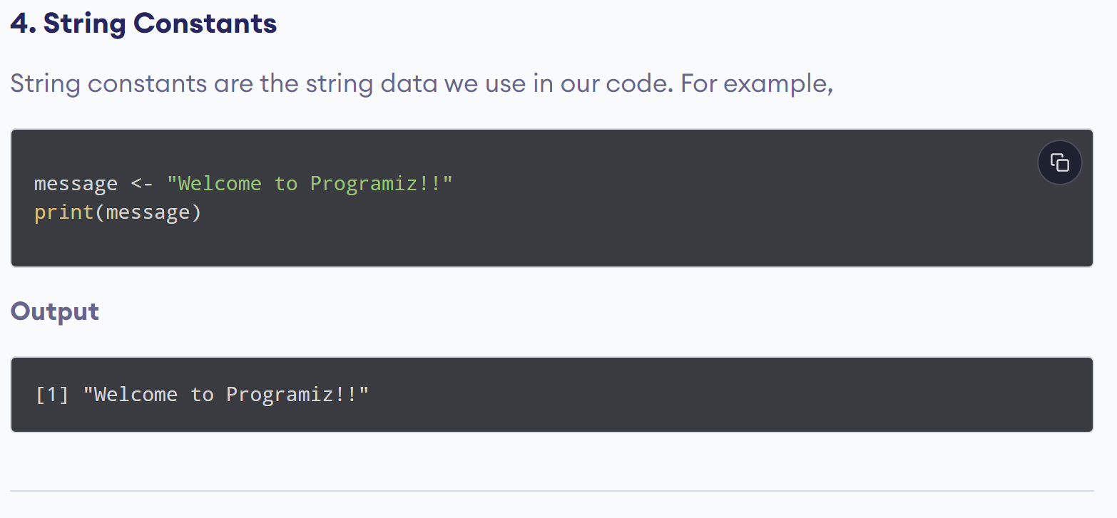
www.lpu.in Lovely Professional University
22

Slide 23
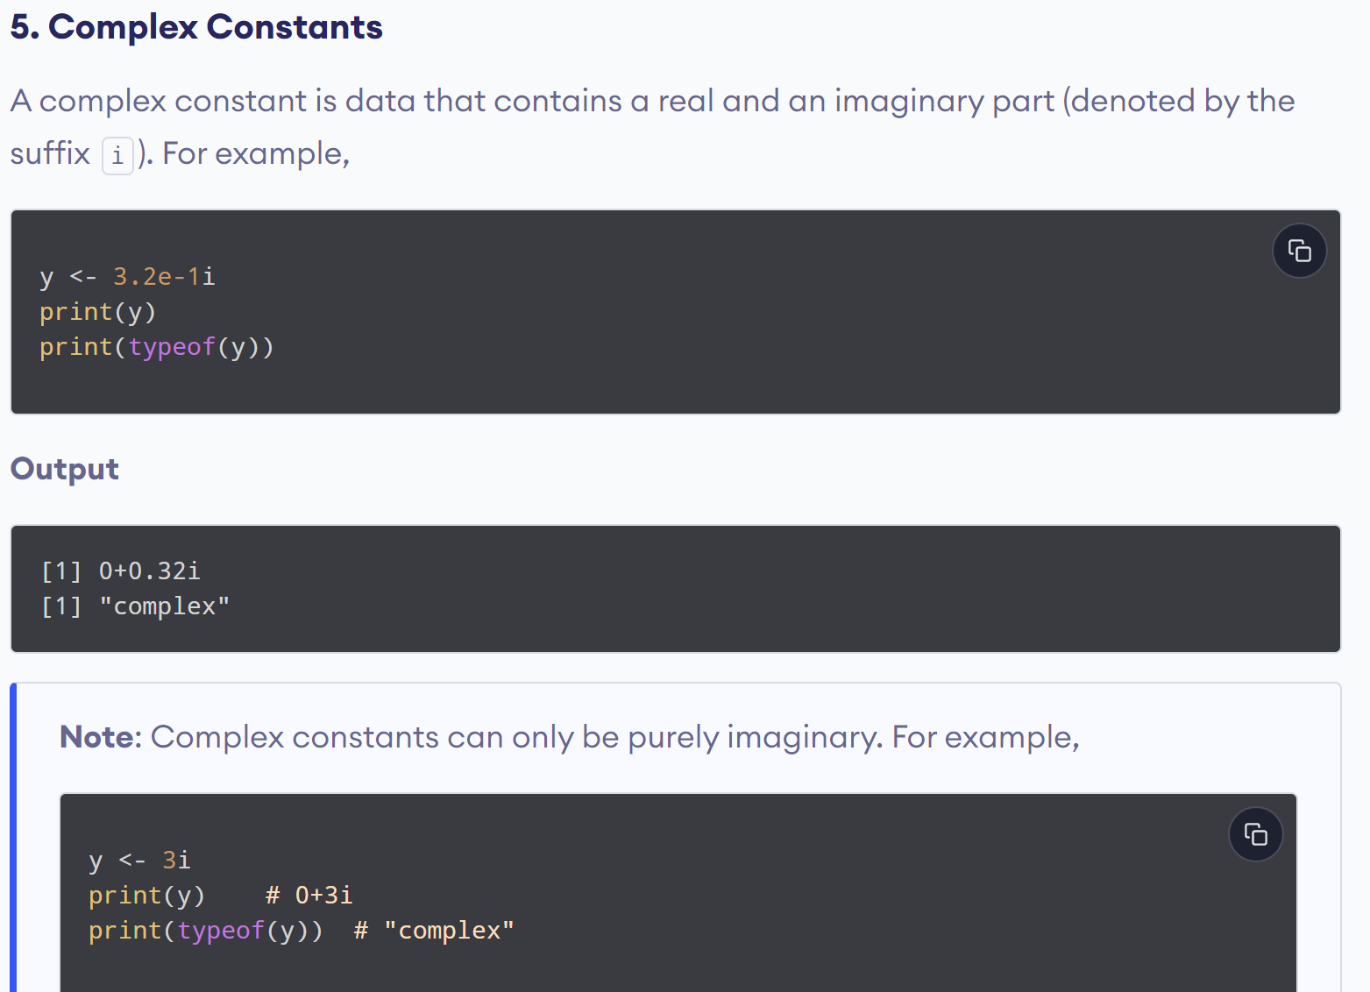
www.lpu.in Lovely Professional University
23

Slide 24
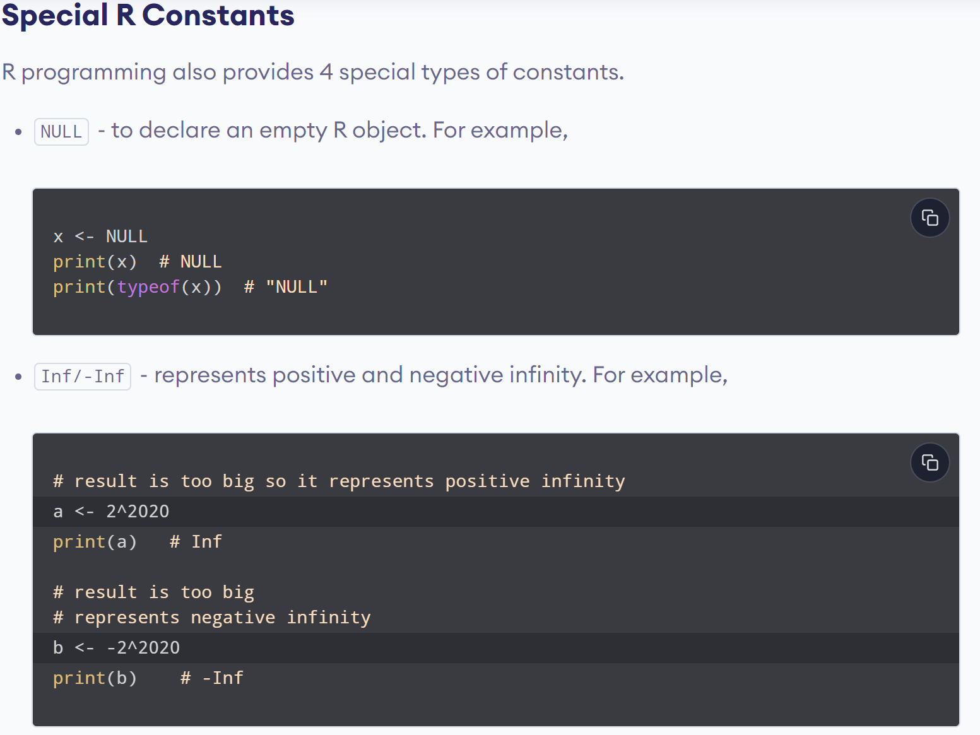
www.lpu.in Lovely Professional University
24

Slide 25
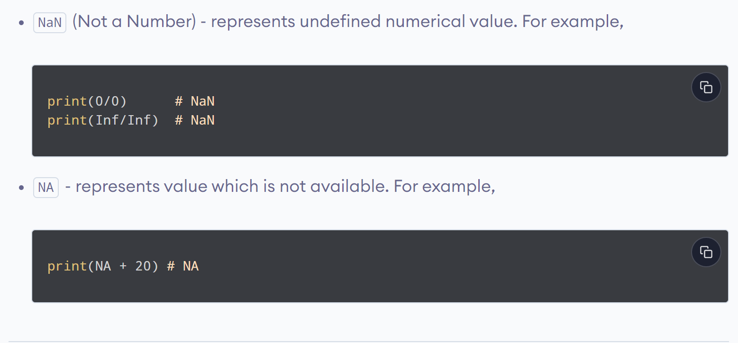
www.lpu.in Lovely Professional University
25

Slide 26
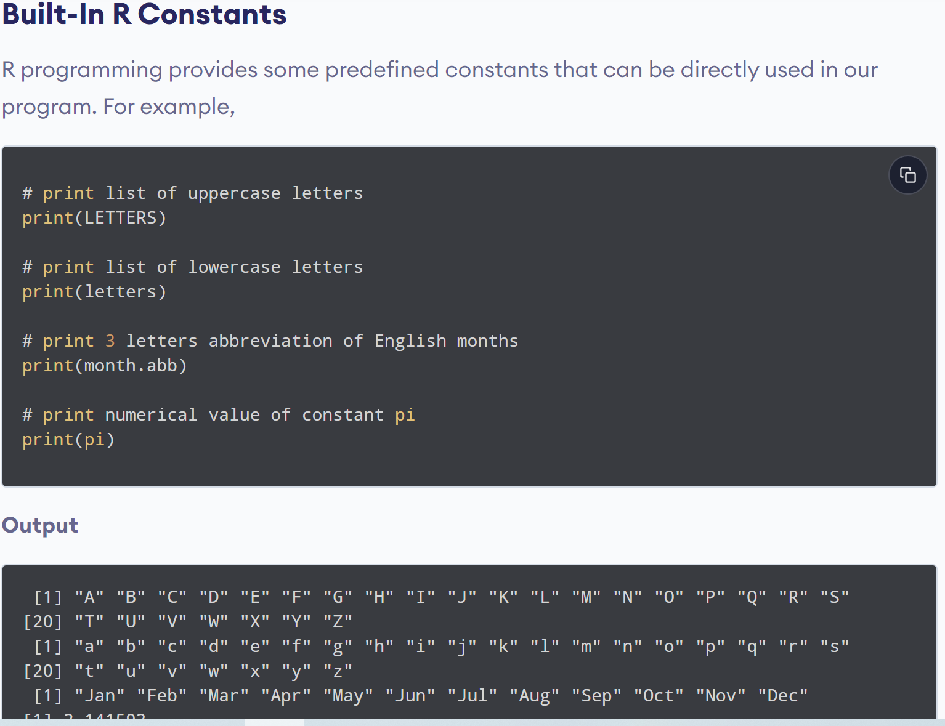
www.lpu.in Lovely Professional University
26

Slide 27
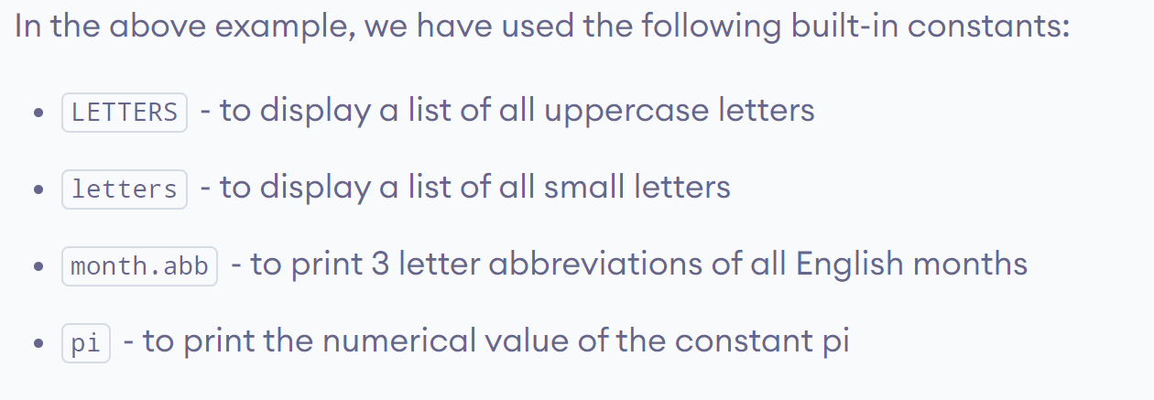
www.lpu.in Lovely Professional University
27

Slide 28

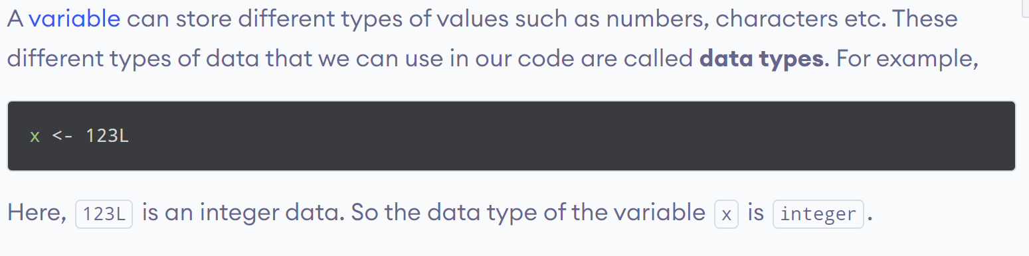
www.lpu.in Lovely Professional University
28

Slide 29
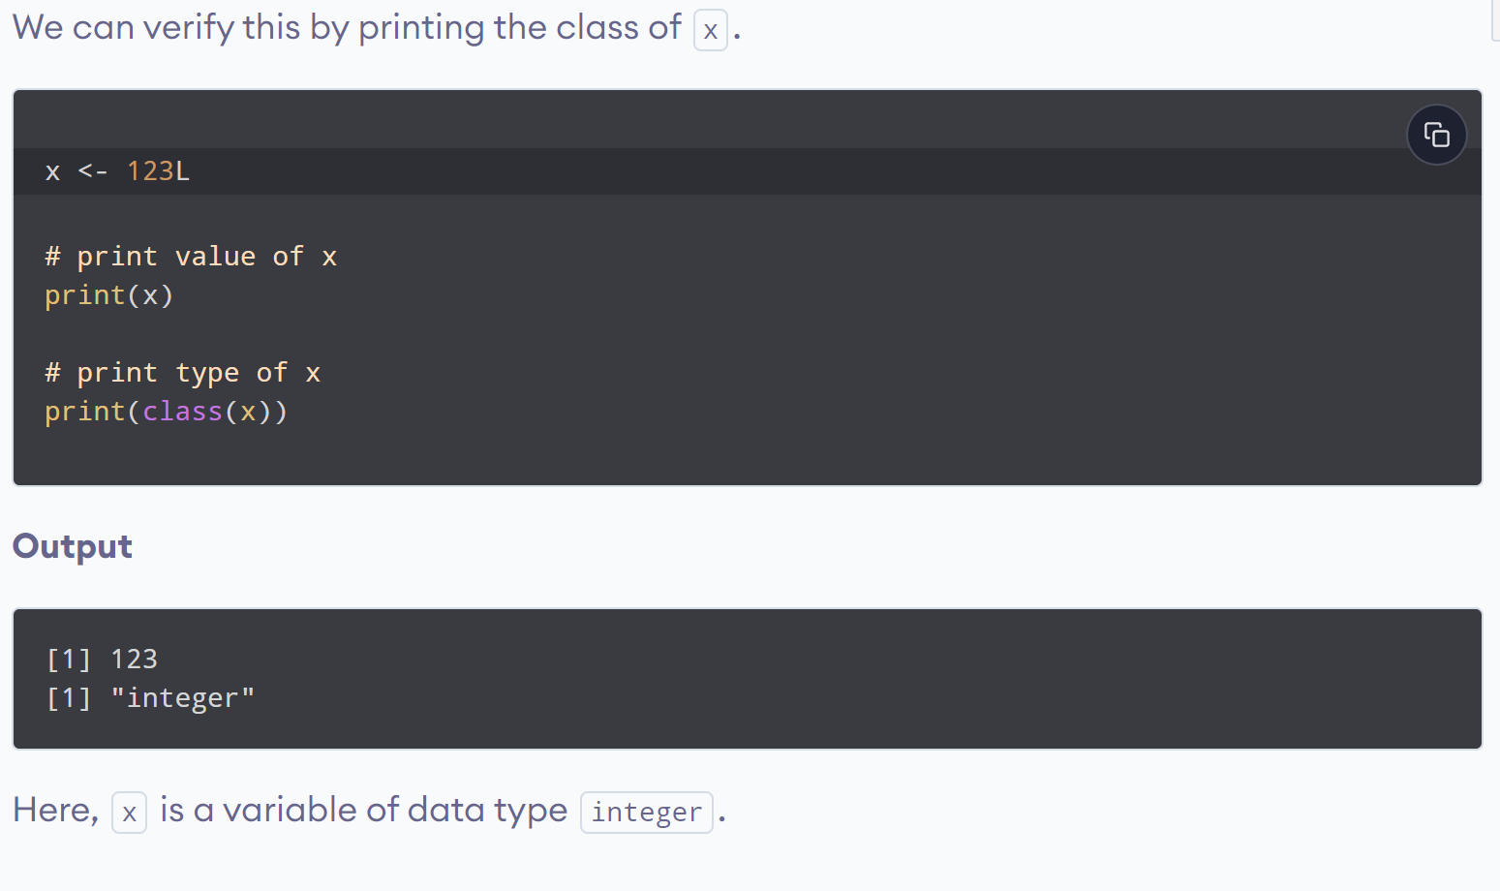
www.lpu.in Lovely Professional University
29

Slide 30
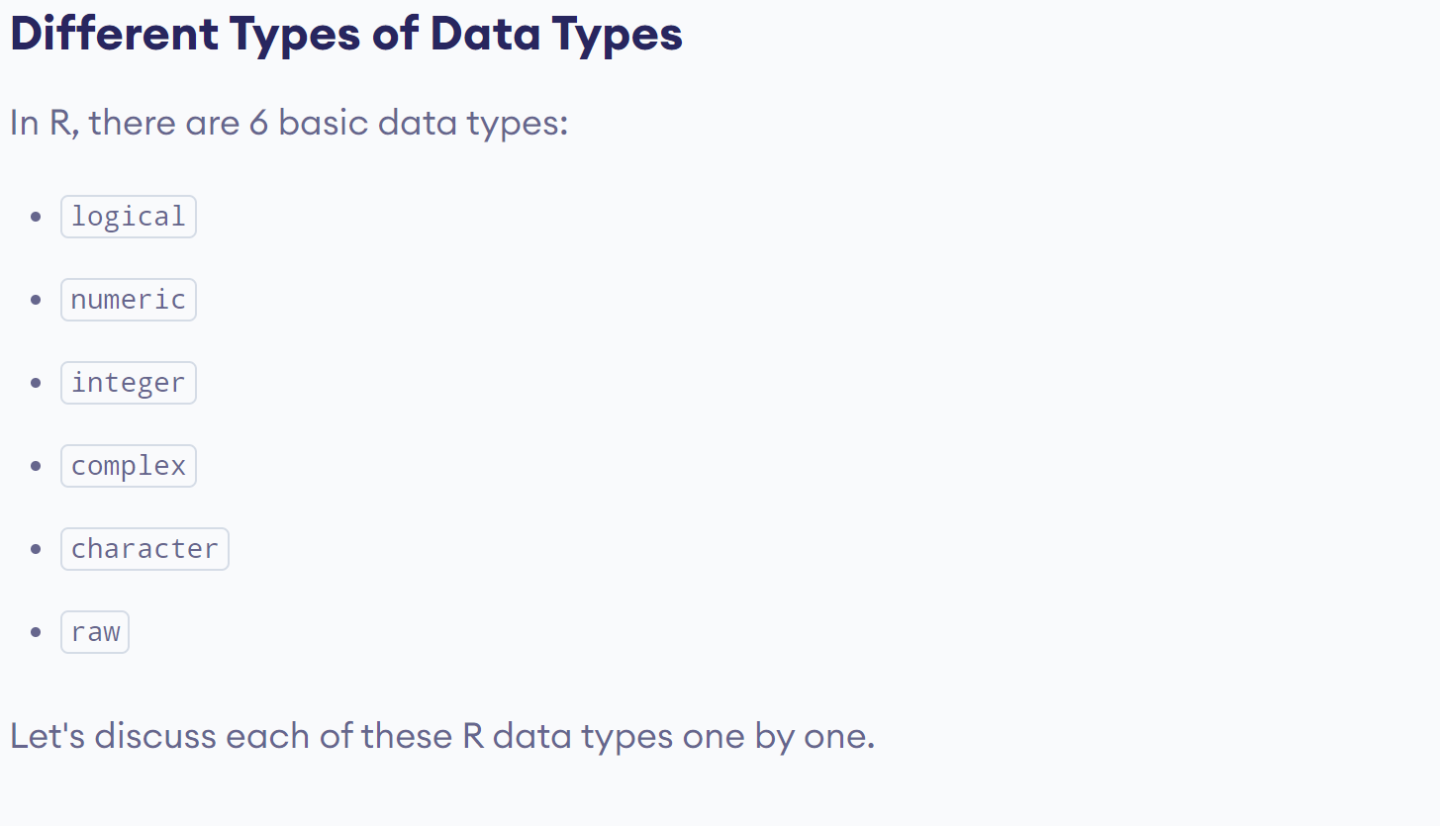
www.lpu.in Lovely Professional University
30

Slide 31
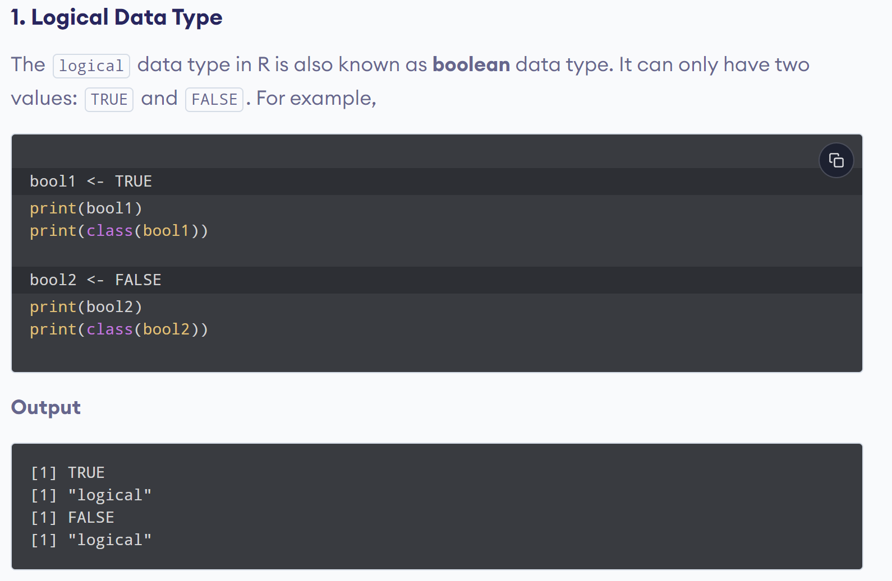
www.lpu.in Lovely Professional University
31

Slide 32
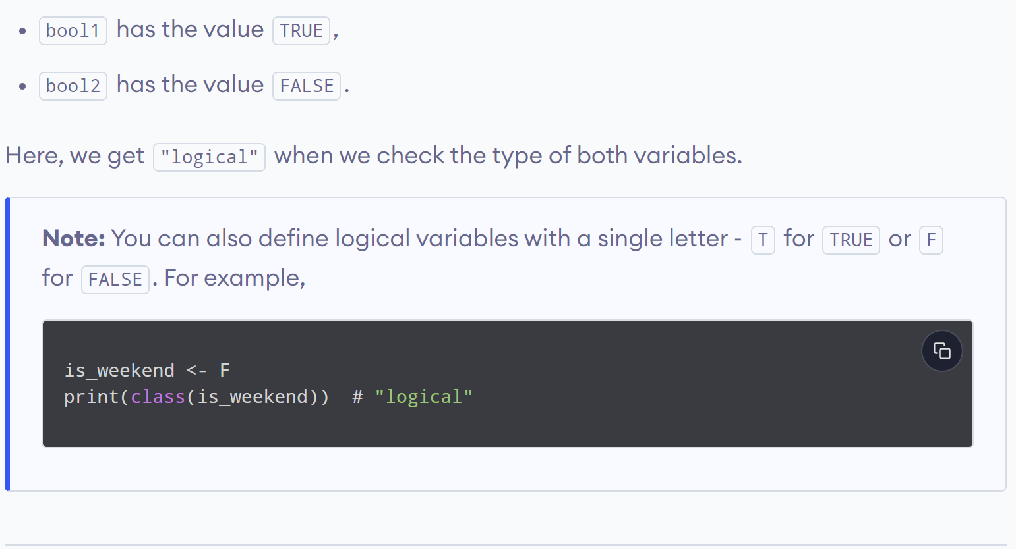
www.lpu.in Lovely Professional University
32

Slide 33
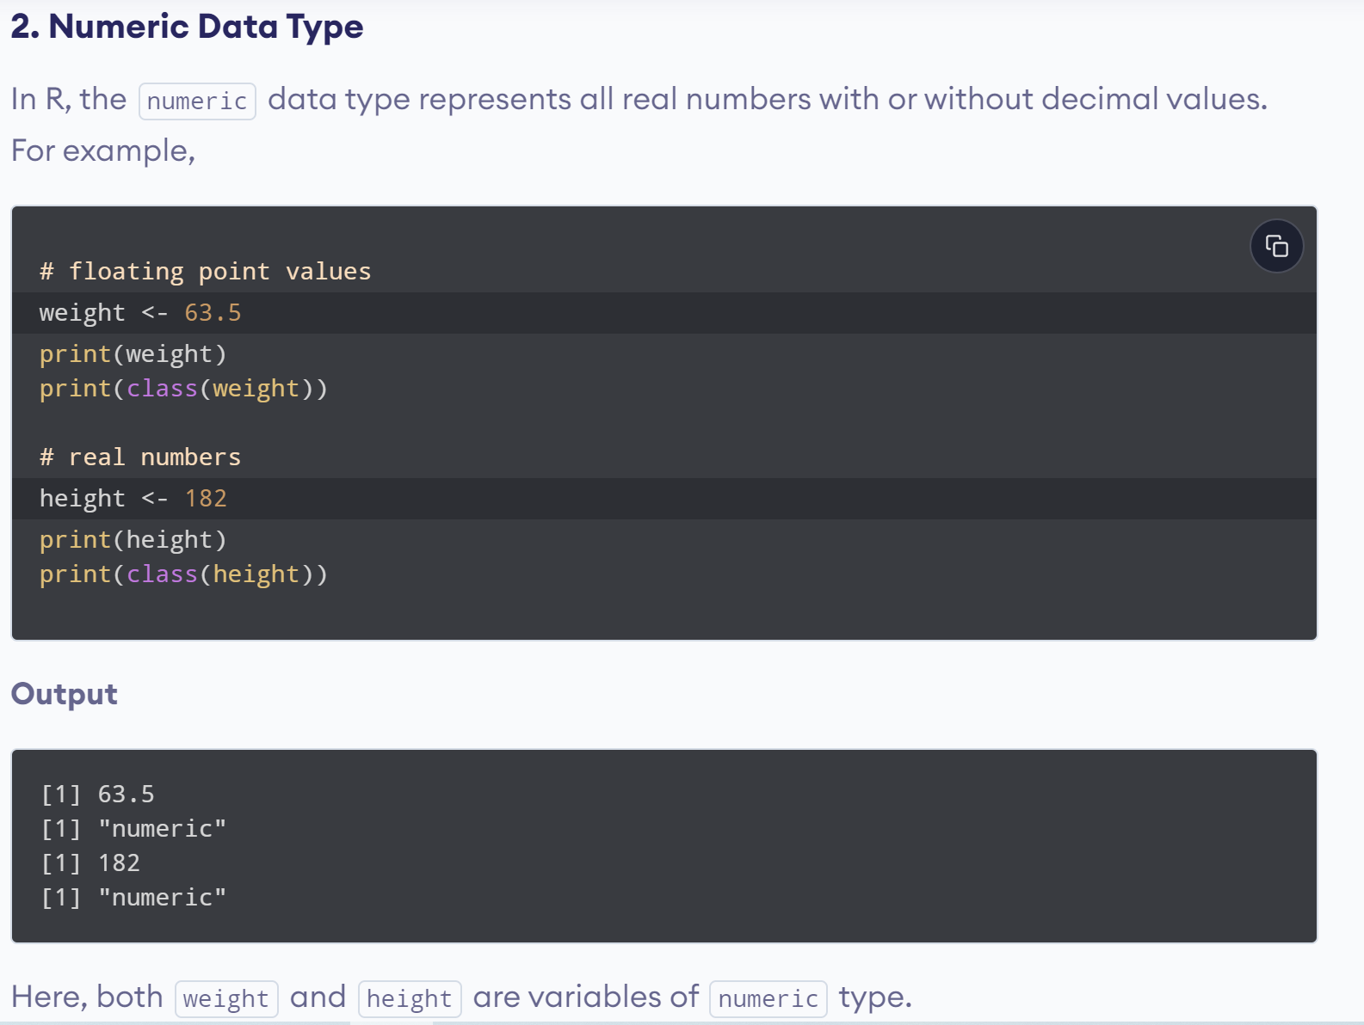
www.lpu.in Lovely Professional University
33

Slide 34
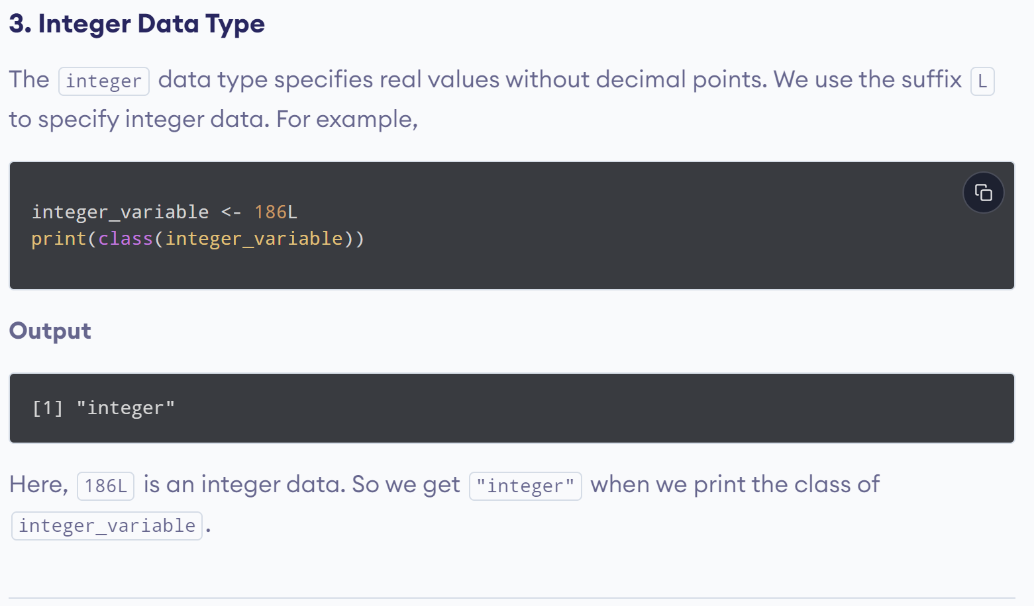
www.lpu.in Lovely Professional University
34

Slide 35
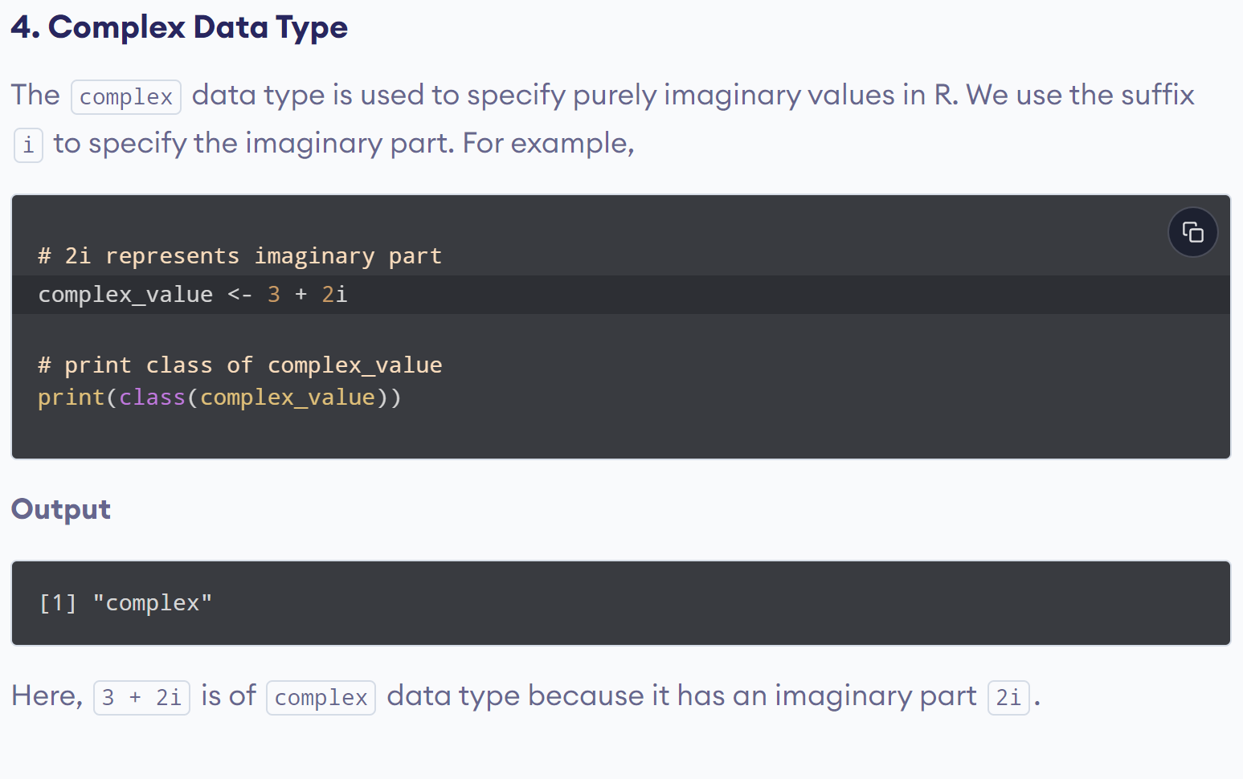
www.lpu.in Lovely Professional University
35

Slide 36
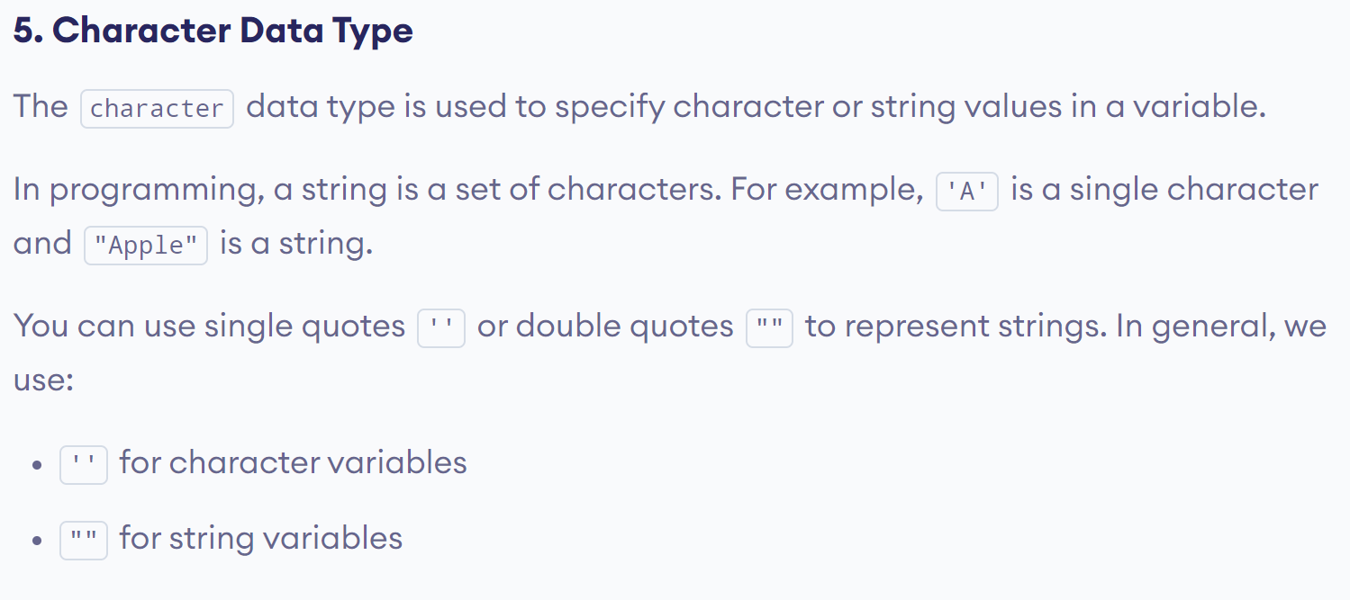
www.lpu.in Lovely Professional University
36

Slide 37
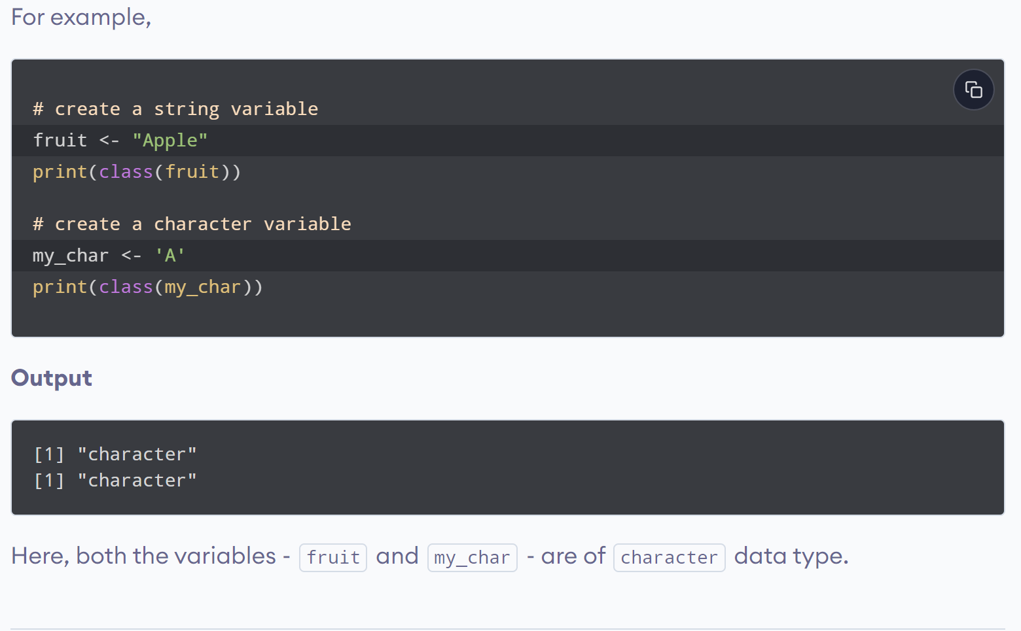
www.lpu.in Lovely Professional University
37

Slide 38
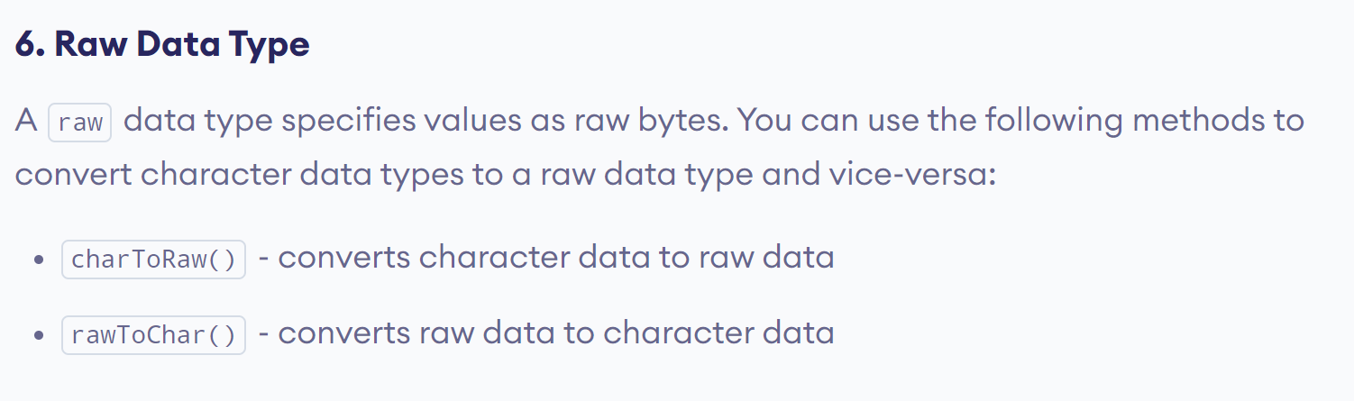
www.lpu.in Lovely Professional University
38

Slide 39
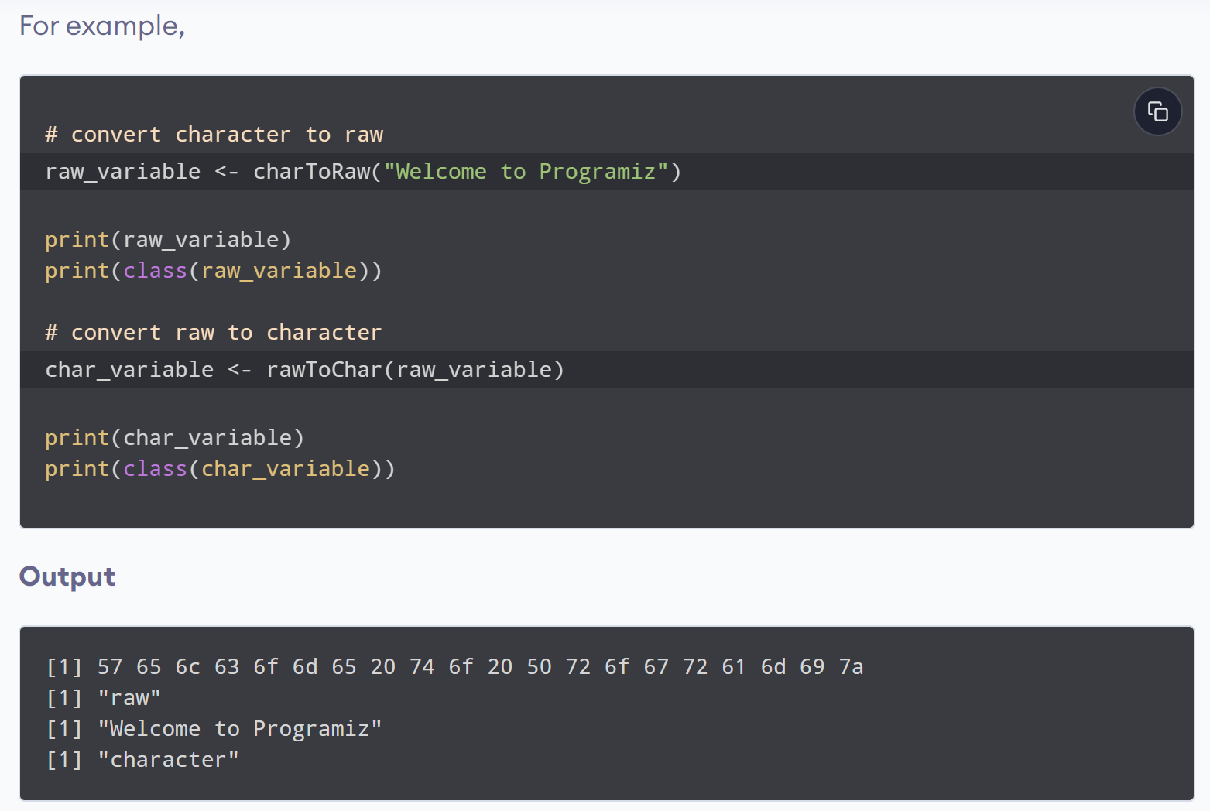
www.lpu.in Lovely Professional University
39

Slide 40
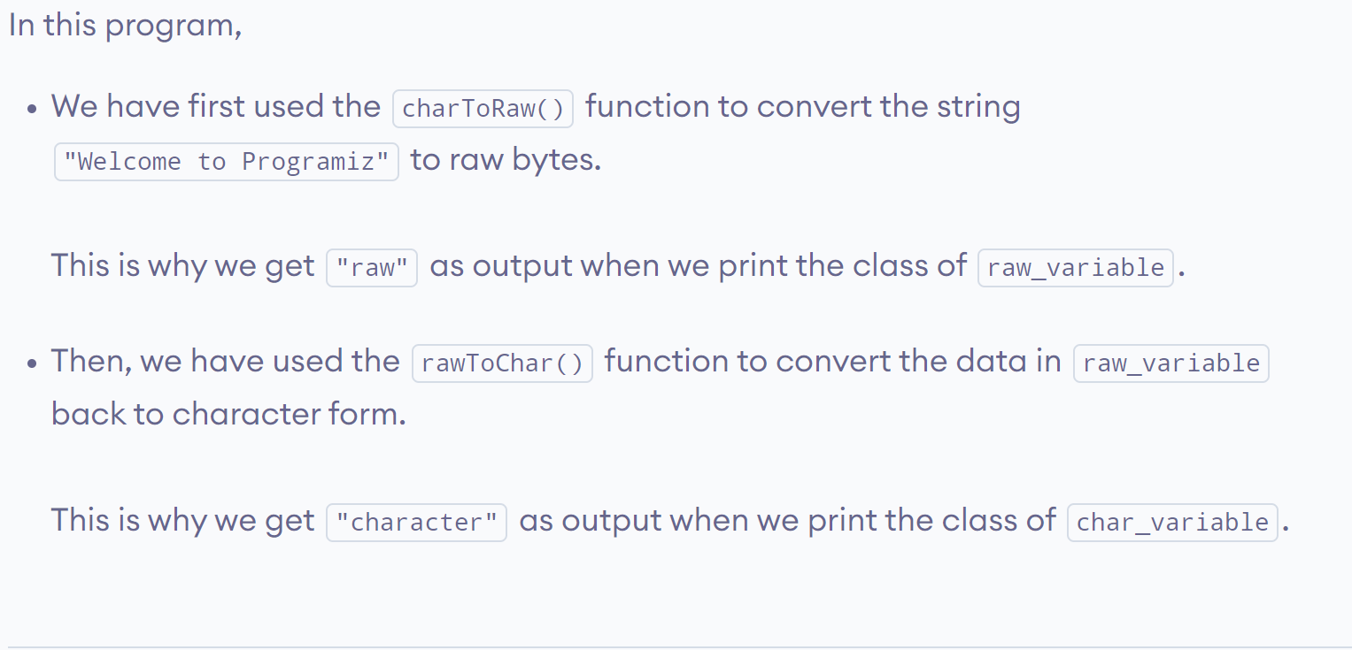
www.lpu.in Lovely Professional University
40

Slide 41

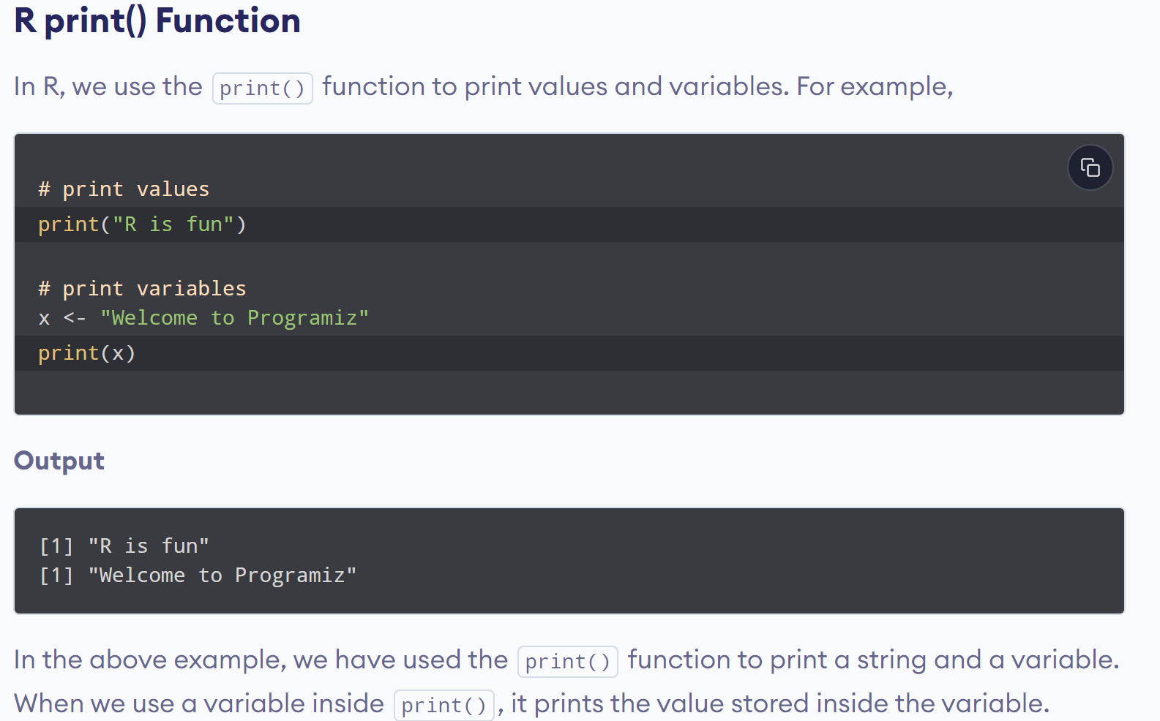
www.lpu.in Lovely Professional University
41

Slide 42
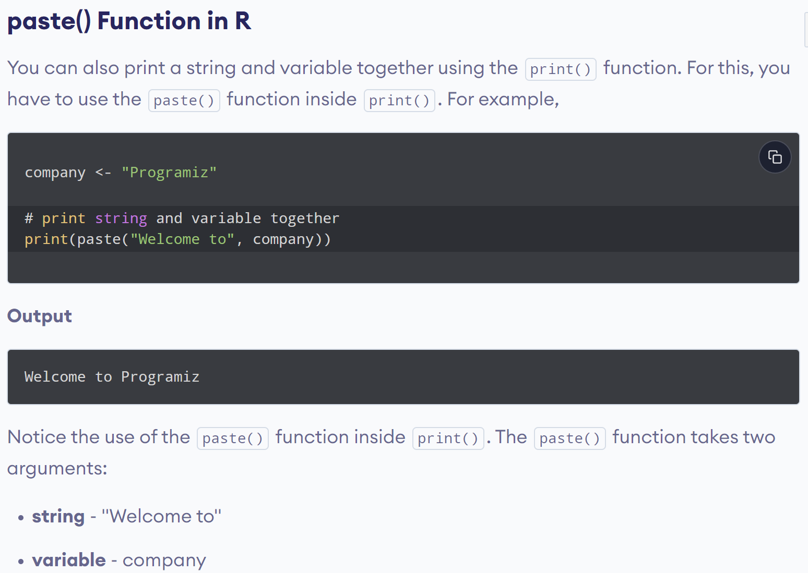
www.lpu.in Lovely Professional University
42

Slide 43
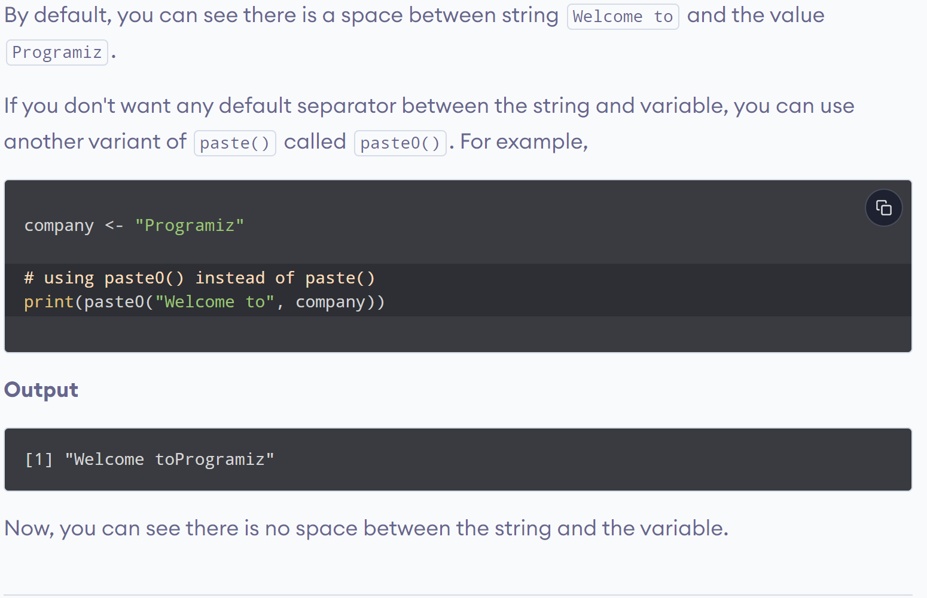
www.lpu.in Lovely Professional University
43

Slide 44
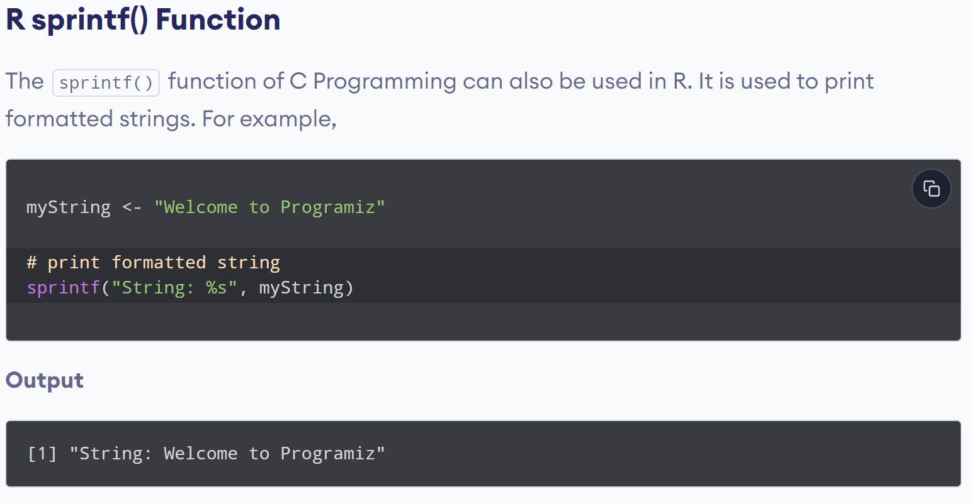
www.lpu.in Lovely Professional University
44

Slide 45
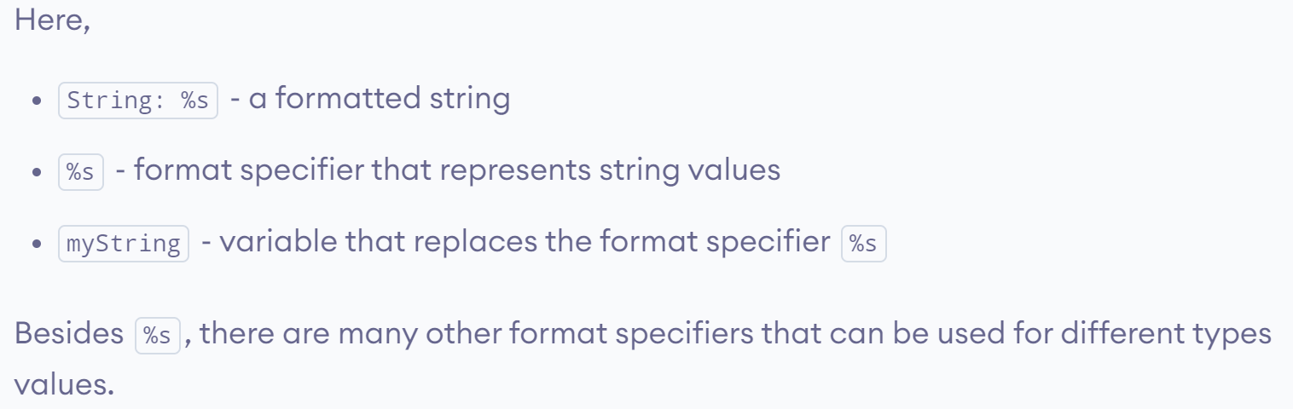
www.lpu.in Lovely Professional University
45

Slide 46
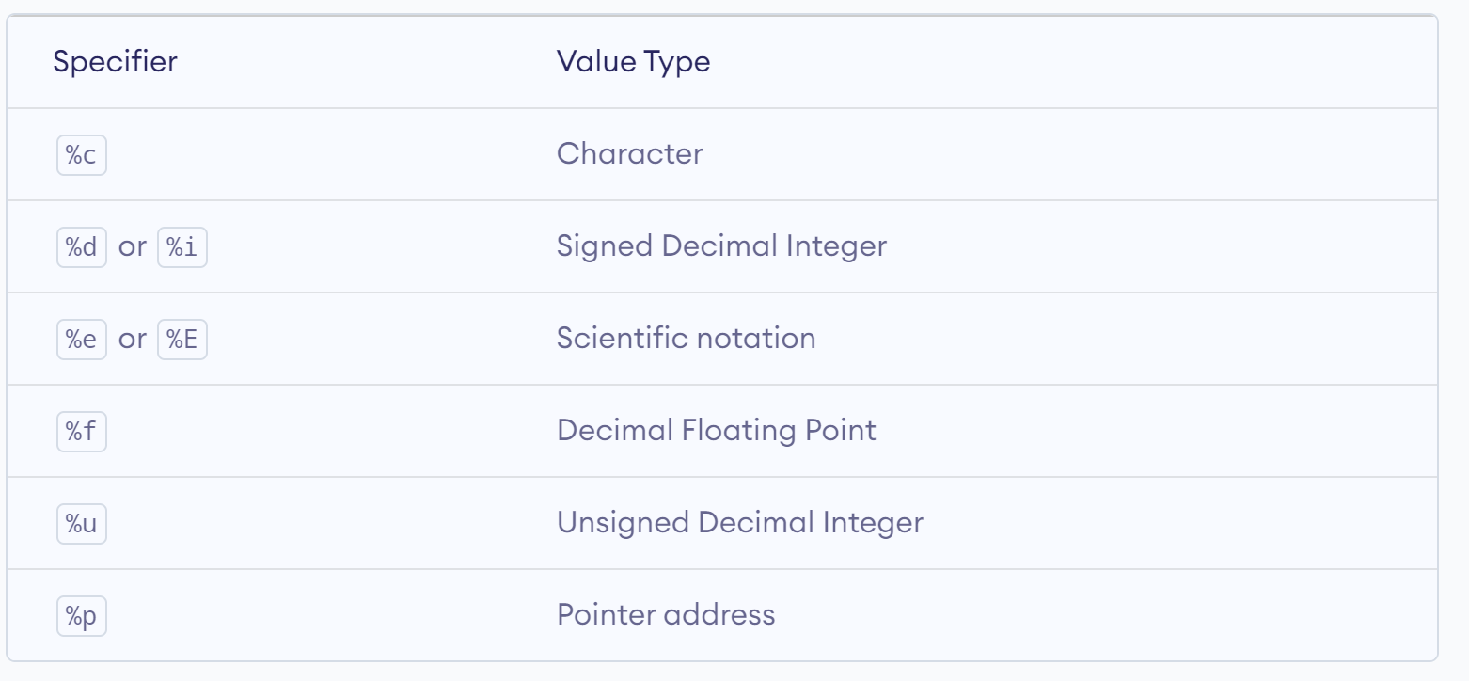
www.lpu.in Lovely Professional University
46

Slide 47
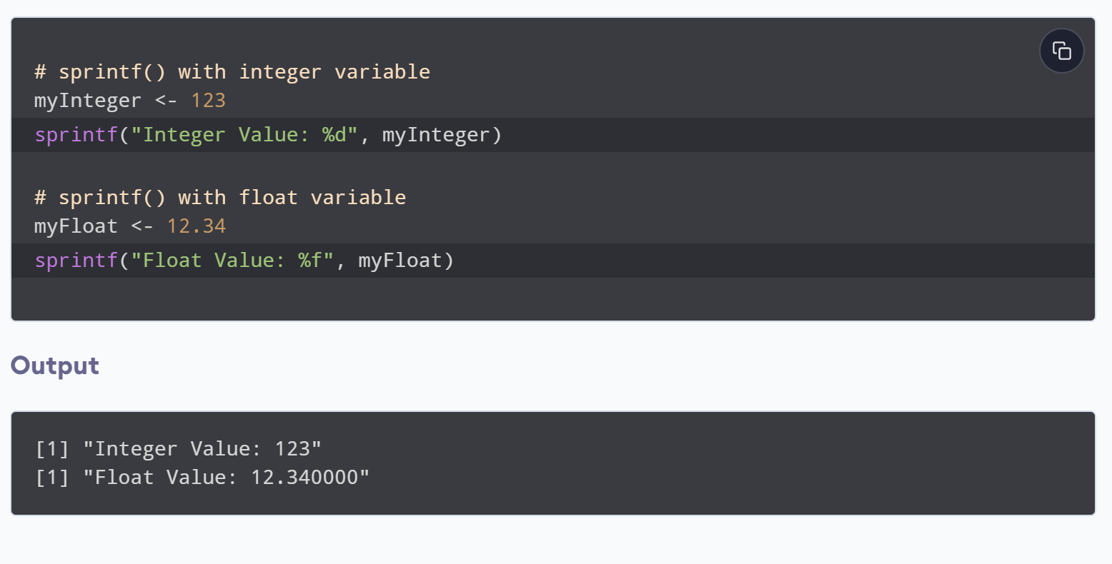
www.lpu.in Lovely Professional University
47

Slide 48
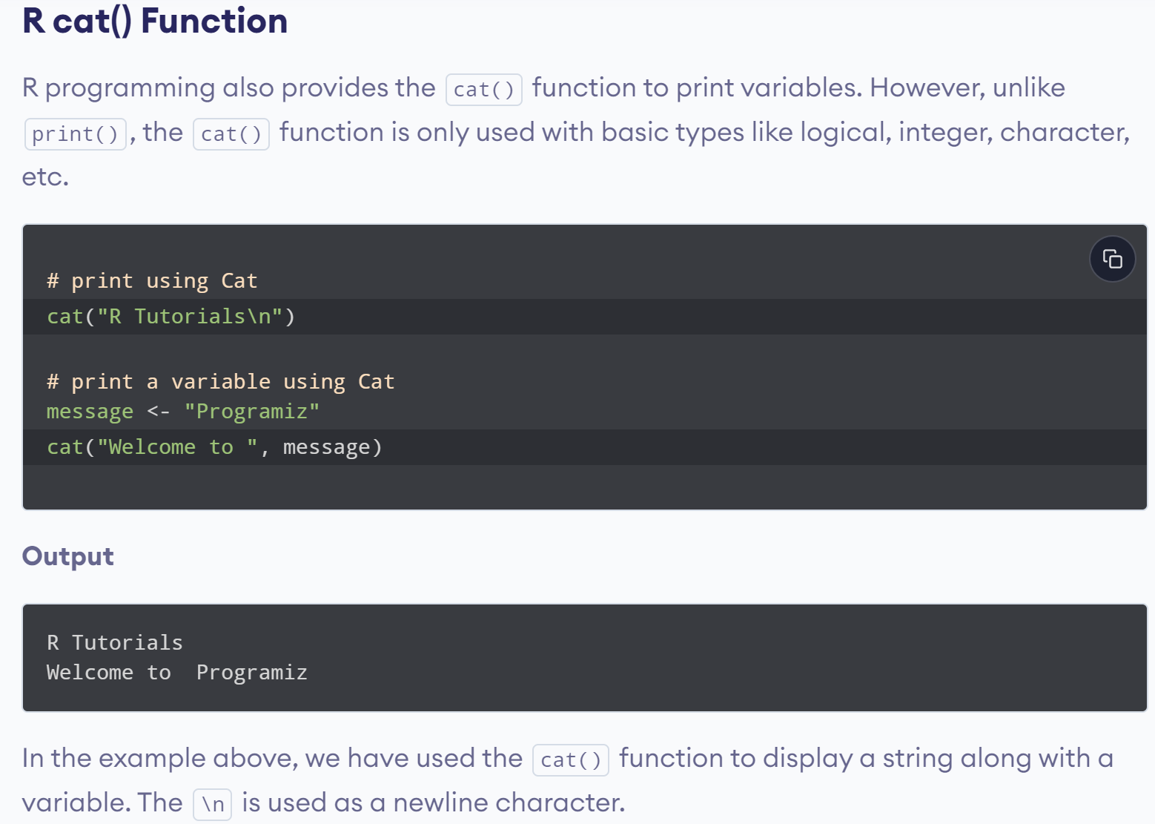
www.lpu.in Lovely Professional University
48

Slide 49
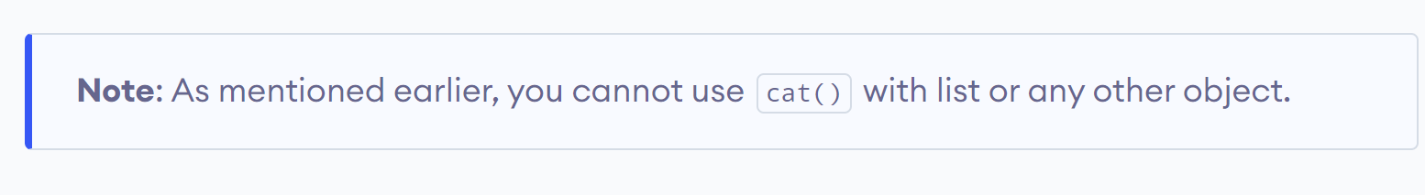
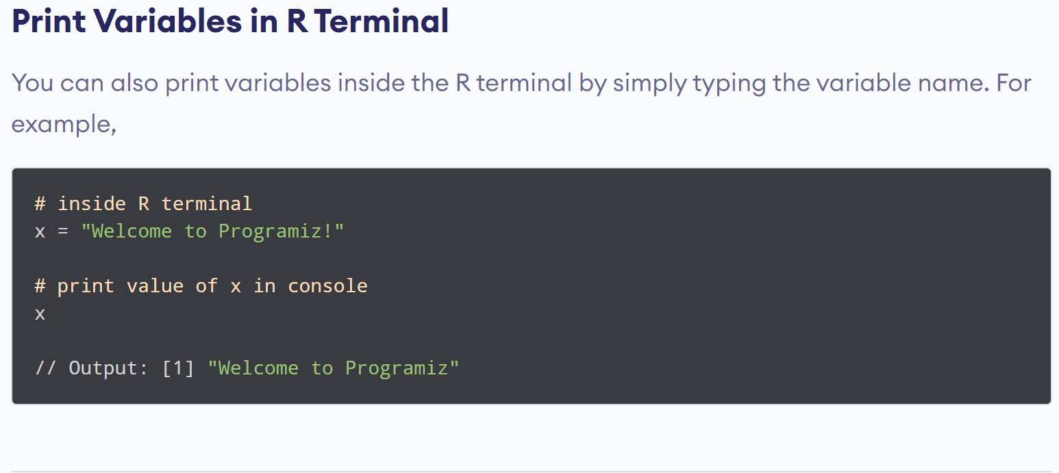
www.lpu.in Lovely Professional University
49

Slide 50

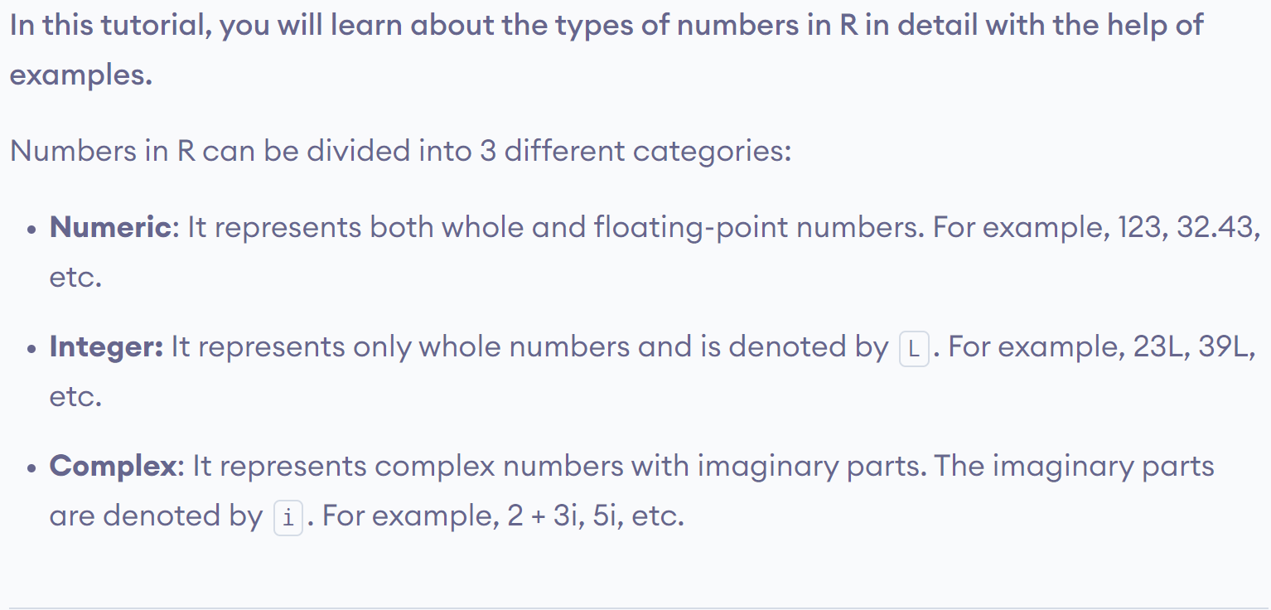
www.lpu.in Lovely Professional University
50

Slide 51

www.lpu.in Lovely Professional University
51

Slide 52


www.lpu.in Lovely Professional University
52

Slide 53

www.lpu.in Lovely Professional University
53

Slide 54

www.lpu.in Lovely Professional University
54

Slide 55
Practice Examples
1. pi*2^3-sqrt(4)
2. abs(12-17*2/3-9)
3. factorial(4)
4. Try to use any of the following , they give you the same answer as they are different form of the same thing.
log(2,10) OR log(2,base=10) Or log10(2)
5. Natural log
Log(2)

Slide 56
6. exp(0.6931472)
7. log10(2)
8. Reverese the logarithm like so:
10^0.30103
9. sin(45*pi/180)

Slide 57
Calling Functions in R
To invoke predefined functions in R, you need to type their names on the R console , followed by comma- separated parameters as arguments within parentheses.
sum(5,26,67,10,56)
Output-164
rep(“hello”,5)
Output-[1] "hello" "hello" "hello" "hello"
[5] "hello"

Slide 58
sqrt(100)
Output-[1] 10
substr(“Example”,2,4)
Output- [1] "xam“
Two R commands can be separated by a semicolon(;) or a newline \n

Slide 59
R – Vectors
1. Vectors in R are the same as the arrays in C language which are used to hold multiple data values of the same type.
2. One major key point is that in R the indexing of the vector will start from ‘1’ and not from ‘0’.
3. Vector is a logical element, which holds the value as well as the magnitude of that value and serves as data structure containers
4. we can easily increase or decrease the container size of a vector to accommodate various data elements

Slide 60
Constructing a vector in R
C(10,20,30,40,50)
Shows the implementation of the c() function to create a vector.
C() function is used to construct a vector. It should be noted that the values or numbers written inside the parenthesis are referred as arguments

Slide 61
A vector can also be created by using the ‘:’operator between the range of numbers
Example:
1:15
(generates numbers from 1 to 15)
Output of the Sequence Operator
[1] 1 2 3 4 5 6 7 8 9 10 11 12 13 14 15

Slide 62
Calculating the sum of a vector
Sum(1:15)
Generates the sum of numbers from 1 to 15
Output:120

Slide 63
Storing and Calculating values in R
R allows you to easily store the intermediate results, so that the stored values can be used later for other calculations
Example:X<-1:15
X
Output:[1] 1 2 3 4 5 6 7 8 9 10 11 12 13 14 15

Slide 64
Now lets create a second variable y , assign the value 30, and add x and y
y<-30
x+y
Output:[1] 31 32 33 34 35 36 37 38 39 40 41 42 43 44 45
Here x+y expression adds the number 30 in the sequence of number 1 to 15.

Slide 65
Combining Text values in R
Example:
a=c(“hello”, “world”)
a
Output: [1] "hello" "world"

Slide 66
Vector with numerical decimals in a sequence
Example: numbers1 <- 1.5:6.5 numbers1
Output:[1] 1.5 2.5 3.5 4.5 5.5 6.5
Example: numbers2 <- 1.5:6.3 numbers2
Output:[1] 1.5 2.5 3.5 4.5 5.5

Slide 67
Vector Length
To find out how many items a vector has, use length() function
Example:
fruits <- c("banana", "apple", "orange")
length(fruits)
Output:[1] 3

Slide 68
Sort a Vector
To sort items in a vector alphabetically or
numerically, use the sort() function:
fruits <- c("banana", "apple", "orange", "mango", "lemon")
numbers <- c(13, 3, 5, 7, 20, 2)
sort(fruits) # Sort a string
sort(numbers) # Sort numbers
Output:
[1] "apple" "banana" "lemon" "mango" "orange" [1] 2 3 5 7 13 20

Slide 69
You can also access multiple elements by referring to different index positions with the c() function:
fruits <- c("banana", "apple", "orange", "mango", "lemon")
# Access first and third item (banana and orange)
fruits[c(1, 3)]
Output:
[1] "banana" "orange"

Slide 70
Change an Item
fruits <- c("banana", "apple", "orange", "mango", "lemon")
# Change "banana" to "pear"
fruits[1] <- "pear"
Fruits
Output:
[1] "pear" "apple" "orange" "mango" "lemon"

Slide 71
Repeat Vectors
To repeat vectors, use the rep() function
Repeat each value:
repeat_each <- rep(c(1,2,3), each = 3)
repeat_each
Output:
[1] 1 1 1 2 2 2 3 3 3

Slide 72
Repeat the sequence of the vector:
repeat_times <- rep(c(1,2,3), times = 3)
repeat_times
Output:
[1] 1 2 3 1 2 3 1 2 3

Slide 73
Entering numerical Items as Data
Add some extra values to create a new(larger) sample
Data1=c(3,5,7,5,3,2,6,8,5,6,9)
Data1
Data2=c(Data1,4,7,10,15)
Data2
Output:[1] 3 5 7 5 3 2 6 8 5 6 9 4 7 10 15

Slide 74
Data1=c(3,5,7,5,3,2,6,8,5,6,9)
Data1
data1=c(14,16,19,Data1)
Data1
Output:[1] 14 16 19 3 5 7 5 3 2 6 8 5 6 9
Now adding Extra values at the beginning has modified the original sample

Slide 75
Entering text item as data
day1=c(“mon”,”tue”,”wed”)
Day1
Output:[1] "mon" "tue" "wed”
If you mix text and numbers, the entire data object becomes a text variable and the numbers are converted to text
Mix=c(data1,day1)
Mix
Output:[1] "14" "16" "19" "3" "5" "7" "5" "3" "2" "6"
[11] "8" "5" "6" "9" "mon" "tue" "wed"

Slide 76
Using scan command for making data
Scan() command do the similar job as that of c()..
Unlike c you don’t need to insert the values in the parentheses but use empty parentheses.
The command then prompt you to enter the data
Once you press the Enter key you will be prompted to enter your data.

Slide 77
Example
>data3=scan()
1: 6 7 8 7 6 3 8 9 10 7
11: 6 9
13:
Read 12 items
> data3
[1] 6 7 8 7 6 3 8 9 10 7 6 9

Slide 78
Entering text as data using scan()
You must tell R to expect that the items typed in are characters , not numbers
To do this you add the what=‘character’ part in the parentheses
Syntax:
scan(what=‘character’)

Slide 79
Example:
> scan(what='character')
1: mon tue wed
4: thu
5:
Read 4 items
[1] "mon" "tue" "wed" "thu"
>

Slide 80
To know all the variables currently available in the workspace we use the ls() function.
print(ls())
Variables can be deleted by using the rm() function.
abc = 15
rm(abc)
All the variables can be deleted by using the rm() and ls() function together.
rm(list=ls())
print(ls())

Slide 81
Getwd() function
The getwd() function is used to display the current working directory of the user.
>getwd()
Creating a vector using seq() function
seq(1,3, by=0.2) #specify step size
Output:[1] 1.0 1.2 1.4 1.6 1.8 2.0 2.2 2.4 2.6 2.8 3.0
seq(1,5, length.out=4) # specify length of vector
Output:[1] 1.000000 2.333333 3.666667 5.000000

Slide 82
Manipulate and Process data in R
A data structure is a specialized format for organizing and data values .
R provides various types of data structures such as vectors and data frames
It also provides various functions to manipulate and process the data stored in different data structures. Eg: subset(), merge() and order

Slide 83
Vector- It is a structure that can contain one or more values of a single type, such as character, number or integer. Vectors are used to represent only one-dimensional data , such as set of digits.
Matrix- It is a two –dimensional vector. You can create a matrix by using matrix() function. This function takes the parameters of numbers to be displayed in either the column or row format. The ncol is used to specify the number of columns , and nrow argument is used to specify the number of rows
Data frames-it is a list of named vectors of the same length. It resembles a spreadsheet or a table in a database with columns and heading for each column. In other words, a data frame can be defined as a matrix in which data is stored in columns having names. Data frames are generally used to represent time series.
List-It is collection of objects that fall under a similar category. A list is not fixed in length and can contain other lists

Slide 84
Various ways to select a part of Vector Object
To create the subsets of data stored in a vector,you can use the subset() function or the [ ] brackets
data1=c(3,5,7,5,3,2,6,8,5,6,9)
> data1
[1] 3 5 7 5 3 2 6 8 5 6 9
> data1[1] # shows the First item
[1] 3
> data1[3] # shows the third item
[1] 7

Slide 85
> data1[1:3]
[1] 3 5 7
> data1[data1>3]
[1] 5 7 5 6 8 5 6 9
> data1[-1] # show all except the first
[1] 5 7 5 3 2 6 8 5 6 9
> data1[data1>3] or subset(data1,data1>3)
[1] 5 7 5 6 8 5 6 9
> data1[data1<5|data1>7]
[1] 3 3 2 8 9

Slide 86
> max(data1)
[1] 9
> min(data1)
[1] 2
> which(data1==max(data1))
[1] 11(eleventh item ie,9 in the vector is the largest)

Slide 87
unmow=c(8,9,7,9,NA)
> sort(unmow,decreasing=T)
[1] 9 9 8 7
>order(unmow)
[1] 3 1 2 4 5
> rank(unmow)
[1] 2.0 3.5 1.0 3.5 5.0

Slide 88
Returning logical values from a vector
>data1=c(3,5,7,5,3,2,6,8,5,6,9)
> data1
[1] 3 5 7 5 3 2 6 8 5 6 9
>which(data1==6)
[1] 7 10
> data1==6
[1] FALSE FALSE FALSE FALSE FALSE FALSE TRUE FALSE FALSE TRUE FALSE

Slide 89
> data1=c(3,5,7,5,3,2,6,8,5,6,9)
> data1
[1] 3 5 7 5 3 2 6 8 5 6 9
> data1>3
[1] FALSE TRUE TRUE TRUE FALSE FALSE TRUE TRUE TRUE TRUE TRUE
> data1<5
[1] TRUE FALSE FALSE FALSE TRUE TRUE FALSE FALSE FALSE FALSE FALSE
> data1>2 & data1<5
[1] TRUE FALSE FALSE FALSE TRUE FALSE FALSE FALSE FALSE FALSE FALSE

Slide 90
Create a subset of texts after removing the word “one” using subset() function
Example:
> t=c("one","one","two","three","four","two")
> t
[1] "one" "one" "two" "three" "four" "two"
> subset(t,t!="one")
[1] "two" "three" "four" "two"
Or
> t[t!="one"]
[1] "two" "three" "four" "two"

Slide 91
Assigning values using vectors
An important difference between the subset() function and the square brackets is that by using square brackets you can assign the values to elements , however you can not do that by using the subset() function
Example:
data1=c(3,5,7,5,3,2,6,8,5,6,9)
> data1
[1] 3 5 7 5 3 2 6 8 5 6 9
data1[data1<3]=7 # to replace the number less than 3 with new number 7
> data1
[1] 3 5 7 5 3 7 6 8 5 6 9

Slide 92
> subset(data1,data1<3)=7
Error in subset(data1, data1 < 3) = 7 : could not find function "subset<-"

Slide 93
The following operators help you to form subsets of data in R
$-the dollar operator is used to select a single element of data . When this operator is used with a data frame, the result is always a vector
[[- The double square brackets operator is used to return a single element. It provides the flexibility of referring the elements by their position rather than by name. Generally, it is used to represent the data stored in data frames and lists
[ ] -the single square brackets operator is used to extract multiple elements of data

Slide 94
Data Frames
Data Frames are data displayed in a format as a table.
Data Frames can have different types of data inside it.
While the first column can be character,
the second and third can be numeric or logical.
However, each column should have the same type of data.
Use the data.frame() function to create a data frame:

Slide 95
> data_frame=data.frame(Training = c("Strength", "Stamina", "Other"),
+ Pulse = c(100, 150, 120),
+ Duration = c(60, 30, 45)
+ )
> data_frame
Training Pulse Duration
1 Strength 100 60
2 Stamina 150 30
3 Other 120 45

Slide 96
> Data_Frame[1]
Training
1 Strength
2 Stamina
3 Other
> Data_Frame[["Training"]]
[1] "Strength" "Stamina" "Other"
>
> Data_Frame$Training
[1] "Strength" "Stamina" "Other"

Slide 97
Add a new row
rbind() function
> # Add a new row
>New_row_DF <- rbind(Data_Frame, c("Strength", 110, 110))
> # Print the new row
> New_row_DF
Training Pulse Duration
1 Strength 100 60
2 Stamina 150 30
3 Other 120 45
4 Strength 110 110

Slide 98
Add Columns
Use the cbind() function to add new columns in a
Data Frame
> New_col_DF <- cbind(Data_Frame, Steps = c(1000, 6000, 2000))
> New_col_DF
Training Pulse Duration Steps
1 Strength 100 60 1000
2 Stamina 150 30 6000
3 Other 120 45 2000

Slide 99
Number of Rows and Columns
> dim(Data_Frame) #dimensions
[1] 3 3
You can also use the ncol() function to find the number of columns and nrow() to find the number of rows
> ncol(Data_Frame)
[1] 3
> nrow(Data_Frame)
[1] 3

Slide 100
> subset(data_frame,Pulse>100)
Training Pulse Duration
2 Stamina 150 30
Other 120 45
> data_frame[data_frame$Pulse>100,]
Training Pulse Duration
2 Stamina 150 30
3 Other 120 45

Slide 101
Creating subsets of Particular Rows and Columns
> subset(data_frame,Pulse>100,select=-Pulse)
Training Duration
2 Stamina 30
Other 45
>subset(data_frame,Pulse>100,select=c(Training,Duration))
Training Duration
2 Stamina 30
3 Other 45

Slide 102
> subset(data_frame,Pulse>100,select=Training:Duration)
Training Pulse Duration
2 Stamina 150 30
Other 120 45
> data_frame[data_frame$Pulse>100,c("Training","Duration")]
Training Duration
2 Stamina 30
3 Other 45

Slide 103


Slide 104


Slide 105


Slide 106


Slide 107


Slide 108
>df=data.frame(x=1:3,y=5:7)
>df x y
1 1 5
2 2 6
3 3 7
>is.data.frame(df)
[1] TRUE

Slide 109
>personnames=c('gremish','symons','simond','guntoo','simond','darek','chran')
> salary=c(9000,30000,4000,5000,6000,700,400)
> bonus=c(800,500,600,200,400,300,1000)
> personnames
[1] "gremish" "symons" "simond" "guntoo" "simond" "darek" "chran"
> salary
[1] 9000 30000 4000 5000 6000 700 400
> bonus
[1] 800 500 600 200 400 300 1000
> company=data.frame(personnames,salary,bonus)
> company personnames salary bonus
1 gremish 9000 800
2 symons 30000 500
3 simond 4000 600
4 guntoo 5000 200
5 simond 6000 400
6 darek 700 300
7 chran 400 1000

Slide 110
> company[[2]]
[1] 9000 30000 4000 5000 6000 700 400
> company[["salary"]]
[1] 9000 30000 4000 5000 6000 700 400
> company$salary [1] 9000 30000 4000 5000 6000 700 400
>company[['personnames']]
[1] "gremish" "symons" "simond" "guntoo" "simond" "darek" "chran“
> company[1,] # display first row of company data frame
personnames salary bonus
1 gremish 9000 800

Slide 111
> head(company,n=5) # display first 5 rows of company data
personnames salary bonus
gremish 9000 800
symons 30000 500
simond 4000 600
guntoo 5000 200
simond 6000 400
>tail(company,n=3)
personnames salary bonus
Simond 6000 400
darek 700 300
chran 400 1000

Slide 112


Slide 113
Managing data in R using Matrices
Creating Matrices:
> matrix(1,3,5) # creates a matrix of 3 rows and 5 columns and all the fields in the matrix are set to 1.
[,1] [,2] [,3] [,4] [,5]
[1,] 1 1 1 1 1
[2,] 1 1 1 1 1
[3,] 1 1 1 1 1

Slide 114
> PQ=1:15 #a series of numbers from 1 to 15 is assigned to a variable ,a.
> matrix(PQ,3,5) # then the matrix function creates a matrix of 3 rows and 5 columns with the numbers stored in the a variable
[,1] [,2] [,3] [,4] [,5]
[1,] 1 4 7 10 13
[2,] 2 5 8 11 14
[3,] 3 6 9 12 15

Slide 115
> matrix(5,5,5) # calling a matrix() function creates a matrix of 5 rows and 5 columns and all the fields in the matrix are set to 5. This is known as square matrix.
[,1] [,2] [,3] [,4] [,5]
[1,] 5 5 5 5 5
[2,] 5 5 5 5 5
[3,] 5 5 5 5 5
[4,] 5 5 5 5 5
[5,] 5 5 5 5 5

Slide 116
Reshaping a vector into matrix
Creating vector and converting it into matrix
> vec=1:20
> dim(vec)=c(4,5)
> vec
[,1] [,2] [,3] [,4] [,5]
[1,] 1 5 9 13 17
[2,] 2 6 10 14 18
[3,] 3 7 11 15 19
[4,] 4 8 12 16 20

Slide 117
Accessing Matrix and subsetting the data
Accessing elements of matrix
> vec[2,4] # display 2nd row , 4th column element of matrix
[1] 14
> vec[2,] # display 2nd row
[1] 2 6 10 14 18
> vec[,3] # display the 3rd column
[1] 9 10 11 12

Slide 118
> vec[,1:3] # displaying first, second and third col.
[,1] [,2] [,3]
[1,] 1 5 9
[2,] 2 6 10
[3,] 3 7 11
[4,] 4 8 12
> vec[,1:4]
[,1] [,2] [,3] [,4]
[1,] 1 5 9 13
[2,] 2 6 10 14
[3,] 3 7 11 15
[4,] 4 8 12 16

Slide 119
> vec[1:3,]
[,1] [,2] [,3] [,4] [,5]
[1,] 1 5 9 13 17
[2,] 2 6 10 14 18
[3,] 3 7 11 15 19
>vec[1,3]=55 # replaces the values of the first row and third col
>vec

Slide 120
>m=matrix(c(3:14),nrow=4,byrow=T)
>m
[,1] [,2] [,3]
[1,] 3 4 5
[2,] 6 7 8
[3,] 9 10 11
[4,] 12 13 14

Slide 121


Slide 122

Matrix Addition & Subtraction

Slide 123

Multiplication & Division

Slide 124
Working with List
#Create a list consisting of strings, numbers, vectors #and logical value:
List1 = list("Hi", "Hello", c(10,20,30), TRUE, 12.34,514.34)
Print(List1)

Slide 125
[[1]]
[1] "Hi"
[[2]]
[1] "Hello"
[[3]]
[1] 10 20 30
[[4]]
[1] TRUE
[[5]]
[1] 12.34
[[6]]
[1] 514.34

Slide 126

Naming a list element

Slide 127


Accessing List Elements

Slide 128

Converting List to Vector

Slide 129

Working with Arrays

Slide 130

Naming Columns and Rows

Slide 131
result
, , 1
[,1] [,2] [,3]
[1,] 5 10 40
[2,] 9 15 50
[3,] 8 30 5
, , 2
[,1] [,2] [,3]
[1,] 9 15 50
[2,] 8 30 5
[3,] 10 40 9

Slide 132

Accessing Array Elements

Slide 133

Manipulating Array Elements

Slide 134
Calculations Across Array Elements
Syntax:
apply(x, margin, fun)
Following is the description of the parameters used −
x is an array.
margin is the name of the data set used.
fun is the function to be applied across the elements of the array.

Slide 135


Slide 136
Working with Factors
Factors are the data objects which are used to categorize the data and store it as levels. They can store both strings and integers. They are useful in the columns which have a limited number of unique values. Like "Male, "Female" and True, False etc. They are useful in data analysis for statistical modelling
Factors are created using the factor () function by taking a vector as input.

Slide 137


Slide 138

Factors in Data Frame

Slide 139

Changing the factor levels

Slide 140
Generating Factor Levels
We can generate factor levels by using the gl() function. It takes two integers as input which indicates how many levels and how many times each level.
Syntax
gl(n, k, labels)
Following is the description of the parameters used −
n is a integer giving the number of levels.
k is a integer giving the number of replications.
labels is a vector of labels for the resulting factor levels.

Slide 141


Slide 142
scan() command using sep
> salaries=scan(sep=',') # defines a separator used in clipboard data
1: 1000,20000,30000,400000,500000,60000,100000,100001,1000001
10:
Read 9 items
> salaries
[1] 1000 20000 30000 400000 500000 60000 100000 100001 1000001

Slide 143
> sal=scan()
1: 100.2
2: 100
3: 30.5
4: 30.6
5: 200
6: 300
7: 400
8:
Read 7 items
> sal
[1] 100.2 100.0 30.5 30.6 200.0 300.0 400.0

Slide 144
To read data separated with spaces
> readfile=read.table(file.choose(),header=TRUE)
> readfile
Salaries
1 1000
2 20000
3 30000
4 400000
5 1000
6 20000
7 30000
8 400000

Slide 145
> rows=as.integer(readline("Rows of matrix: "))
Rows of matrix: 3
> cols=as.integer(readline("Columns of matrix: "))
Columns of matrix: 2
> x=as.integer(readline("Enter starting element of matrix: "))
Enter starting element of matrix: 3
y=as.integer(readline("Enter ending element of matrix: "))
Enter ending element of matrix: 8
> m=matrix(c(x:y),rows,cols)
> m
[,1] [,2]
[1,] 3 6
[2,] 4 7
[3,] 5 8

Slide 146
> x1=as.numeric(readline(prompt = ("Enter first number : ")))
Enter first number : 10
> x2=as.numeric(readline(prompt = ("Enter second number : ")))
Enter second number : 20
> x3=as.numeric(readline(prompt = ("Enter Third number : ")))
Enter Third number : 30
> v1=c(x1,x2,x3)
> v1
[1] 10 20 30

Slide 147
> y1=as.numeric(readline(prompt = ("Enter first number : ")))
Enter first number : 20
> y2=as.numeric(readline(prompt = ("Enter second number : ")))
Enter second number : 10
> y1=as.numeric(readline(prompt = ("Enter Third number : ")))
Enter Third number : 30
> v2=c(y1,y2,y3)
Error: object 'y3' not found
> v2=c(y1,y2,y1)
> v2
[1] 30 10 30
> paste(v1+v2)
[1] "40" "30" "60"

Slide 148
Convert an object into another form
Convert a matrix to a Data Frame
xy=matrix(c(3:14), nrow=4,byrow=T)
rows=c("row1","row2","row3","row4")
cols=c("col1","col2","col3")
matrix(c(3:14), nrow=4,byrow=T, dimnames = list(rows,cols))
xy1=as.data.frame(xy)
xy1
class(xy1)

Slide 149
col1 col2 col3
row1 3 4 5
row2 6 7 8
row3 9 10 11
row4 12 13 14
> xy1=as.data.frame(xy)
> xy1
V1 V2 V3
1 3 4 5
2 6 7 8
3 9 10 11
4 12 13 14
> class(xy1)
[1] "data.frame"

Slide 150
> x2=as.list(xy1)
> x2
$V1
[1] 3 6 9 12
$V2
[1] 4 7 10 13
$V3
[1] 5 8 11 14

Slide 151

Functions

Slide 152
Call the function
power=function(a,b)
+ print(paste("power of a:",a^b))
> power=function(a,b){
+ print(paste("power of a:",a^b))}
> power(2,4)
Output:[1] "power of a: 16"

Slide 153
x=function()
{
Print(“hello”)
}
x()
Output:
[1] "hello"

Slide 154
> show1=function(){
+ z=c(1,2,3,4,5,6,7,8,9,10)
+ table=z*2
+ res=paste(table,sep="")
+ print("table of 2")
+ return(res)}
> show1()
[1] "table of 2"
[1] "2" "4" "6" "8" "10" "12" "14" "16" "18" "20"

Slide 155
> shw=function(){
+ z=c(1,2,3,4,5,6,7,8,9,10)
+ table=z*2
+ res=paste(table,sep="")
+ print("table of 2")
+ print(res)
+ }
> shw()
[1] "table of 2"
[1] "2" "4" "6" "8" "10" "12" "14" "16" "18" "20"

Slide 156
Check the data type of the value
> shw=function(x){
+ z=c(1,2,3,4,5,6,7,8,9,10)
+ if(!is.numeric(x))
+ return(NULL)
+ table=z*x
+ paste(table,sep="")
+ }
> shw(5)
[1] "5" "10" "15" "20" "25" "30" "35" "40" "45" "50"

Slide 157
Writing function without braces
> calsqr=function(y)
+ y*y
> calsqr(5)
[1] 25

Slide 158
Using Arguments in functions
> calcube=function(x,y=3)
+ x^y
> calcube(8)
[1] 512

Slide 159
Calculating the Area of circle
> areacir=function(pi=3.14,r)
+ {
+ ar=pi*r*r
+ paste("area of circle=",ar)
+ }
> areacir(r=5)
[1] "area of circle= 78.5"

Slide 160
Using dot argument in function
> dotarg=function(a,b,...)
+ {
+ res=a+b+...
+ paste("sum of number is",res)
+ }
> dotarg(3,55)
[1] "sum of number is 58”
> dotarg(3,10,30)
[1] "sum of number is 43"

Slide 161
Passing functions as Arguments
> funarg=function(r,pi=3.14,fun=round,...){
+ result=fun(pi*r*r)
+ paste(result)}
> funarg(5)
[1] "78"

Slide 162
Anonymous functions
Functions created without any names are known as anonymous functions. These functions are used for writing one line codes.
An anonymous function can be written like an argument in a function
The entire body of an anonymous function is written as an argument in its body , so you don’t need to provide any name to the function.
Syntax:
Function(argument list)Expression

Slide 163
Example:
(function(pi=3.14,r)pi*r*r)(r=5)
Output:[1] 78.5

Slide 164
Local and Global environment of a function
The workspace of R is known as global environment in which the function operates , whereas , the environment used in a function is known as local environment of the function .The local environment is the subset of the global environment.

Slide 165
r=5
calarea=function(pi=3.14,r=10)
{ a=pi*r*r
rm(r)
b=pi*r*r
print("area of circle before removing r")
print(a)
print("area of circle after removing r")
print(b)}
calarea()

Slide 166
[1] "area of circle before removing r"
[1] 314
[1] "area of circle after removing r"
[1] 78.5

